Slide 1

HPE ProLiant DL360 Gen10 Plus &
HPE Proliant dl380 gen10 plus
CONFIDENTIAL | AUTHORIZED HPE PARTNER USE ONLY

Slide 2

HPE POWERS THE NEXT WAVE OF DIGITAL TRANSFORMATION
Intelligent compute foundation for hybrid cloud
HPE ProLiant
,
Unmatched workload optimization
360-degree security
Intelligent automation
As-a-service experience

Slide 3
UNMATCHED WORKLOAD OPTIMIZATION
The foundational intelligence of HPE compute transforms IT with insights that optimize workload performance, placement, and efficiency, delivering better outcomes faster
Leveraging HPE experience so companies can focus on their business
Delivering cost-effective and robust workloads quickly
Single-vendor accountability/one-stop shop experience
Solution service offerings from HPE GreenLake and
HPE Pointnext Services
VDI
Workload Solutions
Services attach
& aaS-enabled
Transcoding/ Visualization
Data
Management
Data
Analytics
Containers
Hybrid
Cloud

Slide 4

360-DEGREE SECURITY
The world’s most secure industry-standard server portfolio¹ provides an enhanced holistic, 360-degree view to security that begins in the manufacturing supply chain and concludes with
a safeguarded, end-of-life decommissioning
Cybercrime to reach
Ransomware to cost world economy
$10.5T
by 2025²
$20B
in 2021²
Cybercrime to grow
66%
15% YoY
Trusted supply chain
Automated security
Secure repurposing/retirement of infrastructure
Zero trust architecture
struggle to protect complex and dynamically changing attack surfaces³
for next 5 years²
30%
of CISOs’ effectiveness will be measured on the role’s ability to create value for the business, by 2023⁴
SUPPLY CHAIN
SILICON
DIGITAL FINGERPRINT
EARLY DETECTION
AUTOMATED RECOVERY
RETIREMENT
Holistic security view
¹ Based on external firm conducting cyber security penetration testing of a range of server products from a range of manufactures, 2020
² Cybersecurity Ventures, Top 5 Cybersecurity Facts, Figures, Predictions, And Statistics For 2020 To 2021
³ HPE and Ponemon Institute Global Study 2020: Closing the IT Security Gaps
⁴ Gartner, Rethink the Security and Risk Strategy, Tom Scholtz 2020

Slide 5

INTELLIGENT AUTOMATION
The intelligence built into HPE compute simplifies and automates management tasks, establishing a solid foundation for an open, hybrid cloud platform enabled by composability
Easily deploy infrastructure faster, more securely
Software-defined infrastructure that is future-proofed
Automate and enable IT to focus on more strategic projects
Accelerate business with dev-friendly infrastructure
Predict and prevent issues before they adversely impact business operations
Securely configure, monitor, and update servers seamlessly, from anywhere

Slide 6

AS-A-SERVICE EXPERIENCE
Free up capital, boost operational and financial flexibility, and free up talent to accelerate what’s next for you
HPE greenlake
The cloud that comes to you
Get faster time to market
Save on TCO, align costs to business
Scale quickly, meet unpredictable demand
Simplify IT operations across your data centers and clouds
EDGES
COLOCATION/DATACENTERS
CLOUDS
Self-service
Pay-per-use¹
Scale up
and down
Managed for you
75%
40%
147%
30–40%
shorter time to deployment²
IT resource savings²
estimated ROI²
TCO savings²
¹ Reserve may apply
² Based on external security firm conducting cyber security penetration testing of HPE Gen10 servers and three leading server competitors, September 2019.

Slide 7
12-MONTH ROADMAP: HPE PROLIANT RACK SERVERS with intel processors
ProLiant rack servers | Q2 CY2021 | Q3 CY2021 | Q4 CY2021 | Q1 CY2022
DL20 Gen10
DL20 Gen10 Plus
DL110 Gen10 Plus
DL160 Gen10
DL180 Gen10
DL360 Gen10
DL360 Gen10 Plus
DL380 Gen10
DL380 Gen10 Plus
DL560 Gen10
DL580 Gen10
New—Addition to the portfolio
New—Extension of DL360 offering
New—Extension of DL380 offering
■ Shipping ■ Planned

Slide 8
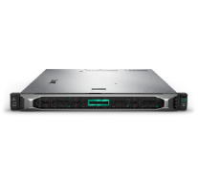
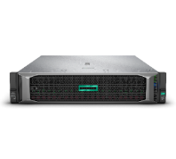
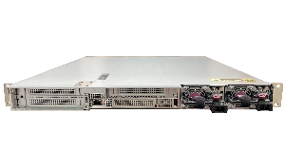
INTRODUCING HPE PROLIANT gen10 plus RACK SERVERS powered by
Intel® 3rd generation xeon® scalable processors
Telco server
for Open RAN
Rack optimized
dense solution
Accelerator optimized
solution
1U, 1P
HPE ProLiant DL110 Gen10 Plus
1U, 2P
HPE ProLiant DL360 Gen10 Plus
2U, 2P
HPE ProLiant DL380 Gen10 Plus
5G infrastructure/access Baseband processing, fronthaul edge | IT infrastructure Physical, virtual, containerized | Software Defined Storage, AI/ML Media Streaming, Structured Data Analytics, NFV
Optimized for Telco vRAN workloads Shorter depth chassis (17”) | Significantly improved NVMe SSD support Vast arrange of storage backplanes Slot-less HW RAID M.2, NS204i-r riser | Dramatically enhanced storage capabilities Broad drive cages/trays portfolio AROC/OCP lane recovery modules Rear drives

Slide 9
HPE PROLIANT DL360 Gen10 Plus product overview

Slide 10
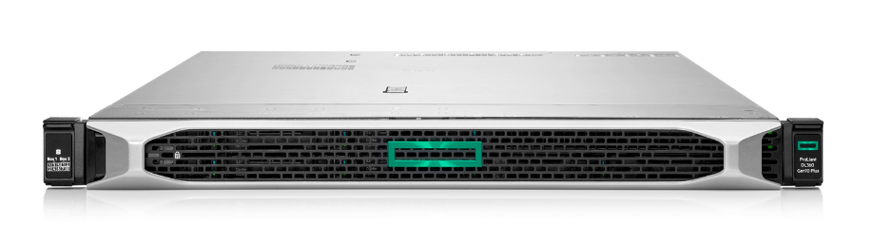
The premium standard for multi-workload environments
HPE ProLiant DL360 Gen10 Plus Server
Extension to HPE’s DL360 portfolio, accelerating application and storage performance via augmented computing and I/O capabilities, built on proven security and management tenets.
Primary Jobs-to-be-Done/Workloads
In both virtualized and bare metal deployments:
Empower users to thrive/Applications (collaborative,
content, business)
Extract knowledge from data/Data management and analytics
Architect a reliable and scalable foundation/IT and communications–e.g., Telco 5G—infrastructure.
Launch: 6-April-2021
Freedom to choose:
Gen10 Plus: Performance oriented
Gen10: Budget focus
Running in parallel throughout lifecycle.
Key Features/Benefits
Fully enables 3rd Gen Intel Xeon SP processor capabilities/Enhanced performance and security.
Double I/O bandwidth with PCIe Gen4/Faster connectivity to surrounding infrastructure.
Significantly improved NVMe SSD support/Rapid and
safeguarded data access & storage.
Notes:
Running in parallel with Gen10 through lifecycle
3rd Gen Intel Xeon SP processors
Extends Gen10 capabilities: HW RAID (M.2, NVMe), SED support, unencumbered fw access, etc.
Improved balanced I/O capabilities (cards, NVMe SSDs)
Significantly improved NVMe SSD support: VROC/SR100i, up to 10 direct access drives, tri-mode controller support
Silicon Root of Trust, Advanced Security, Infosight and OneView key differentiators

Slide 11
HPE ProLiant DL360 Gen10 & Gen10 Plus features
 | HPE ProLiant DL360 Gen10 | HPE ProLiant DL360 Gen10 Plus
Compute | Up to (2) 2nd Generation Intel® Xeon® Processor Scalable family, up to 28 Cores Full stack (minus T processors) Up to (2) UPI links per CPU (Up to 10.4 GT/s) PCIe Gen3, up to three (3) available slots; 48 lanes 16x/x8 default primary riser Basic balanced I/O capabilities (no South PCIe lines, no PCIe lane recovery) | Up to (2) 3rd Generation Intel® Xeon® Processor Scalable family, up to 40 Cores Full Stack (minus T & Q processors) UPI: up to (3) Links per CPU (Up to 11.2 GT/s) PCIe Gen4: Up to three (3) available slots; 64 lanes (48 N + 16 S) x16/x16 default primary riser; AROC PCIe lanes re-route adapter Improved balanced I/O cap. (16 S. PCIe lanes, AROC PCIe lane rec.)
Memory | (24) DDR4, 6 ch. per socket, up to 2933MT/s (3.0 TB+ max) | (32) DDR4, 8 channels per socket, up to 3200 MT/s (6.0 TB+ max) DIMM blanks required on empty slots (most configs)
Persistent Memory | Up to 12 HPE Persistent Memory featuring Intel® Optane™ DC persistent memory (3TB max per socket depending on processor model) Or up to 12 NVDIMMs HPE Scalable Persistent memory (192GB max) | Up to 16 Intel® Optane™ Persistent Memory 200 series (4TB max per socket)
Storage | 12 lanes embedded 6Gb AHCI/RAID SATA HPE Smart Array S100i SW RAID Choice of HPE Smart Array Controllers for performance or additional features Optional M.2 capable primary riser | 14 lanes embedded 6Gb AHCI/RAID SATA Intel VROC & HPE Smart Storage SR100i with NVMe support Choice of storage controllers, including tri-mode options for performance or additional features Optional M.2 primary riser, HW RAID capable
HDD/SSD | Smart Drives and Smart Carriers Max 11 (10 front+1 rear) SATA/SAS SFF; up to 10NVMe SSD; Max of 4 LFF (all front) +1SFF rear SATA/SAS NVMe U.2 SFF SSD support; NVMe AIC, M.2 enablement & uFF options | HPE drives on Basic Carriers Max of 10 (all front) SFF SATA/SAS/NVMe Max of 4 LFF (all front) SATA/SAS NVMe U.2 & U.3 SFF SSD support; NVMe AIC, M.2 enablement options. Choice of backplanes (bays, protocols, bandwidth, etc.)
Networking | 4x1GbE embedded + Choice of FlexibleLOM + Standup | No embedded LOM. Choice of OCP 3.0 + Standup
■ Differences in Bold

Slide 12
HPE ProLiant DL360 Gen10 & Gen10 Plus features (continued)
 | HPE ProLiant DL360 Gen10 | HPE ProLiant DL360 Gen10 Plus
VGA/Serial/USB/SD Ports | Front Display Port Opt, Rear VGA & Optional Serial, 5 USB 3.0, + 2 USB 2.0 optional, microSD & optl. RAID1 protected dual micro-SD. Front Management port and dedicated rear iLO port | Front Display Port Opt, Rear VGA & Optional Serial, 5 USB 3.0, + 2 USB 2.0 optional. Opt. for RAID1 protected dual micro-SD. Front Management port and dedicated rear iLO port
GPU Support | Up to (2) Single wide up to 9.5” | Up to (2) Single wide up to 9.5”
BIOS | Legacy & UEFI modes | Legacy & UEFI modes
Management—Embedded | HPE iLO 5, SUM, RESTful Interface Tool | HPE iLO 5, SUM, RESTful Interface Tool
Power & Cooling | Up to 96% eff. To 1600W | Up to 96% efficiency to 1600W; 1000W Low-Line 96% efficient
Industry Compliance | ASHRAE A3 & A4, lower idle power, Energy Star | ASHRAE A3 & A4, lower idle power, Energy Star
Chassis | Twelve variations (4 LFF/8 SFF/10 SFF, emb. LOM/NC & TAA compliance) Depth: 27.83” (SFF), 29.5” (LFF) | Two Network Choice (NC) variations: 4 LFF & 8 SFF TAA via feature code Depth: 29.2” (SFF), 30.4” (LFF)
Security | Silicon Root of Trust from HPE Optional Chassis Intrusion Detection Kit Optional TPM Module Optional Bezel Lock Kit | Silicon Root of Trust from HPE Optional Chassis Intrusion Detection Kit TPM Module by default Optional Bezel Lock Kit Trusted Supply Chain (DL360T) Trigger SKU
Serviceability | Easy Install and Ball Bearing rail kits Optional Cable Management Arm | Easy install rail kit Optional Cable Management Arm
Warranty | 3/3/3 | 3/3/3
Operational Services | HPE Foundation Care HPE Proactive Care | HPE Pointnext Tech Care
■ Differences in Bold

Slide 13
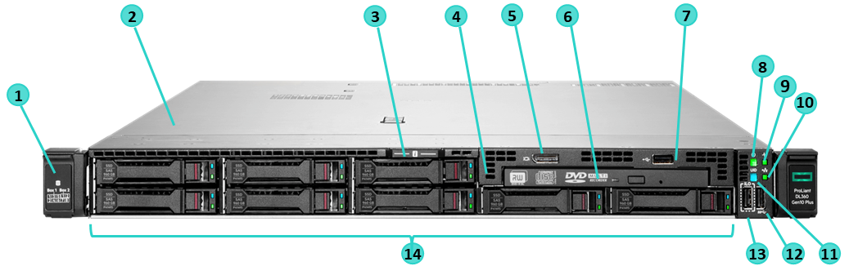
HPE ProLiant DL360 Gen10 plus Server
8 SFF Front of system detail
Drive support label
Quick removal access panel
Serial number label pull tab
Universal Media Bay (optional):
  Shown: Optical drive bay + Display port & USB 2.0 port kit
  Option: +2 SFF 12G x1 SAS/SATA cage
  Option: +2 SFF 24G x4 Tri-Mode U.3 cage
  Option: +2 SFF 16G x4 NVMe U.2 cage
Display port
Optical drive (optional—shown)
USB 2.0 port
Power On/Standby button and system power LED
Health LED
NIC status LED
UID button/LED
USB 3.0 port
iLO Service Port¹
Drive bays; backplane choices:
  Option: 8 SFF 12G x1 SAS/SATA
  Option: 8 SFF 24G x1 Tri-Mode U.3
  Option: 8 SFF 24G x4 Tri-Mode U.3
  Option: 8 SFF 16G x4 NVMe U.2
¹ Optional System Insight Display (SID) module will include #8–12 above (will not include #13—iLO Service Port).

Slide 14
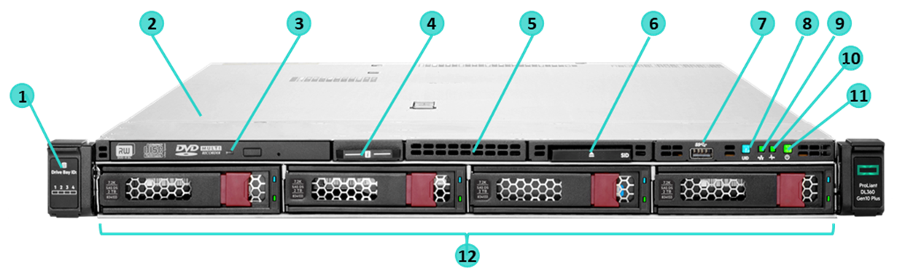
HPE ProLiant DL360 Gen10 plus Server (continued)
4 LFF Front of system detail
Drive support label
Quick removal access panel
Optical drive (optional—shown)
Serial number label pull tab
Option: Display port & USB 2.0 port Kit (blank shown)
Option: System insight Display (SID)—shown¹
USB 3.0 Port
UID button/LED
NIC status LED
Health LED
Power On/Standby button and system power LED
SAS/SATA drive bays
¹ This option will lose #7—iLO Service Port

Slide 15
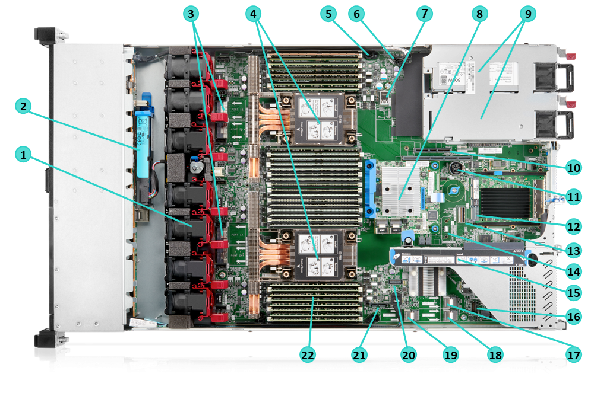
HPE ProLiant DL360 Gen10 plus Server (continued)
Interior of system detail
1. | Hot plug fans (single rotor standard)
 | 1 CPU—5 fans
 | 2 CPUs—7 fans
 | Option: High Performance fans
2. | Option: HPE Smart Hybrid Capacitor or HPE Smart Storage Battery
3. | 4 x8 NVMe ports (1A—2B)
4. | Up to 2 processors (shown with high performance
 | heat sinks)
5. | Optional Chassis Intrusion Detection connector
6. | Hard Drive backplane power connector
7. | Dual internal USB 3.0 connector
8. | Storage Controller (Type—a shown)
9. | Up to 2 Power Supplies for redundant power
10. | Secondary (CPU2) PCIe 4.0 riser
 | Option: Low Profile x16 Option: Full Height x16¹
11. | System Battery
12. | x16 OCP connector (supports various NICs up to 200GbE)
13. | Vertical slimline SAS connector (AROC lane recovery)
¹ Lose slot 2 on Primary riser

Slide 16
HPE ProLiant DL360 Gen10 plus Server (continued)
Interior of system detail
14. | TPM 2.0—Optional on Configure-to-Order Models
15. | Primary (CPU1) PCIe 4.0 riser (Standard: GPU power connector + 2x 16 slots)
 | Option: 1 x16 and 1 x8 slots + x2 PCIe M.2 connectors with HW RAID support
 | (SFF only): 1 x16 and 1 x8 slots + 1 x8 NVMe connector
16. | Option: Front Display port/USB 2.0 connector
17. | x4 SATA port 1
18. | x4 SATA port 2
19. | x4 SATA port 3
20. | Front Power USB 3.0 connector
21. | Optical/SATA port
22. | DDR4 DIMM slots (Fully populated 32 DIMMs shown)

Slide 17
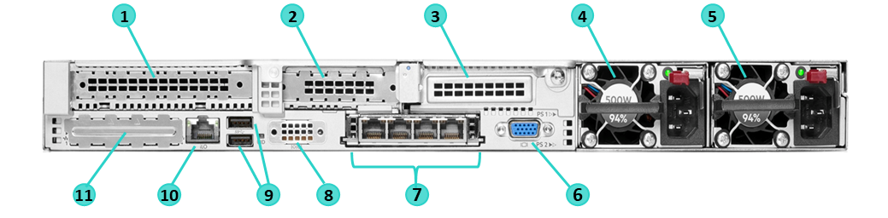
HPE ProLiant DL360 Gen10 plus Server (continued)
Rear view of system detail
1. | Slot 1 PCIe 4.0—Full Height | 6. | VGA port
2. | Slot 2 PCIe 4.0—Low Profile | 7. | OCP NIC ports (if equipped)
3. | Option: Slot 3 PCIe 4.0 (Requires 2nd processor) |  | 200GbE through 1GbE options
 | Low Profile and Full Height options | 8. | Serial port (optional)
4. | Power Supply 2 | 9. | USB 3.0 Ports
5. | Power Supply 1 | 10. | iLO Management Port
 |  | 11. | Blank cover, not available for use

Slide 18
HPE ProLiant DL360 Gen10 plus Server (Replaced controllers)
Pre-Configured Models
Feature | P55243-xx1 | P55242-xx1 | P55241-xx1
Localization | -B21 (WW) & -291 (Japan) | -B21 (WW) & -291 (Japan) | -B21 (WW) & -291 (Japan)
Proc Model | 5315Y (8 core, 3.2GHz, 140W) | 4314 (16 core, 2.4GHz, 135W) | 4310 (12 core, 2.1GHz, 120W)
Heatsink | Standard Heat Sink | Standard Heat Sink | Standard Heat Sink
Fan | 5 – High Performance | 5 – High Performance | 5 – High Performance
Number of Procs | 1 | 1 | 1
Memory | 32GB (1 x 32GB DIMM) & 31 DIMM blanks | 32GB (1 x 32GB DIMM) & 31 DIMM blanks | 32GB (1 x 32GB DIMM) & 31 DIMM blanks
Storage Controller | Broadcom MR416i-a/4GB NVMe/SAS 12G | Broadcom MR416i-a/4GB NVMe/SAS 12G | Broadcom MR416i-a/4GB NVMe/SAS 12G
Smart Storage Battery | 96W Smart Storage Battery | 96W Smart Storage Battery | 96W Smart Storage Battery
Backplane | 8SFF U.3 x1 tri-mode | 8SFF U.3 x1 tri-mode | 8SFF U.3 x1 tri-mode
HDD | N/A | N/A | N/A
NIC | Broadcom BCM57416 Ethernet 10Gb 2-port BASE-T OCP3 | Broadcom BCM57416 Ethernet 10Gb 2-port BASE-T OCP3 | Broadcom BCM57416 Ethernet 10Gb 2-port BASE-T OCP3
Management | iLO 5 | iLO 5 | iLO 5
Power Supply | 800W Flex Slot Platinum Hot Plug Low Halogen | 800W Flex Slot Platinum Hot Plug Low Halogen | 800W Flex Slot Platinum Hot Plug Low Halogen
Expansion Slots | 2 | 2 | 2
ODD | Opt. DVD-RW or DVD-ROM | Opt. DVD-RW or DVD-ROM | Opt. DVD-RW or DVD-ROM
Security | TPM Module | TPM Module | TPM Module
Rail Kit | 1U SFF Easy Install Rail Kit | 1U SFF Easy Install Rail Kit | 1U SFF Easy Install Rail Kit
SID | Optional | Optional | Optional
Universal Media Bay | Optional | Optional | Optional
Warranty | 3/3/3 | 3/3/3 | 3/3/3

Slide 19
HPE ProLiant DL360 Gen10 plus Server (2 New configs)
Pre-Configured Models
Feature | P55240-xx1 | P55239-xx1
Localization | -B21 (WW) & -291 (Japan) | -B21 (WW) & -291 (Japan)
Proc Model | 4309Y (8 core, 2.8GHz, 105W) | 4309Y (8 core, 2.8GHz, 105W)
Heatsink | Standard Heat Sink | Standard Heat Sink
Fan | 5 – High Performance | 5 – Standard
Number of Procs | 1 | 1
Memory | 32GB (1 x 32GB DIMM) & 31 DIMM blanks | 32GB (1 x 32GB DIMM) & 31 DIMM blanks
Storage Controller | Broadcom MR416i-a/4GB NVMe/SAS 12G | HPE SR100i Gen10 Plus FIO Software RAID
Smart Storage Battery | 96W Smart Storage Battery | N/A
Backplane | 8SFF U.3 x1 tri-mode | 8SFF SAS/SATA
HDD | N/A | N/A
NIC | Broadcom BCM57416 Ethernet 10Gb 2-port BASE-T OCP3 | Broadcom BCM57416 Ethernet 10Gb 2-port BASE-T OCP3
Management | iLO 5 | iLO 5
Power Supply | 800W Flex Slot Platinum Hot Plug Low Halogen | 800W Flex Slot Platinum Hot Plug Low Halogen
Expansion Slots | 2 | 2
ODD | Opt. DVD-RW or DVD-ROM | Opt. DVD-RW or DVD-ROM
Security | TPM Module | TPM Module
Rail Kit | 1U SFF Easy Install Rail Kit | 1U SFF Easy Install Rail Kit
SID | Optional | Optional
Universal Media Bay | Optional | Optional
Warranty | 3/3/3 | 3/3/3

Slide 20
HPE ProLiant DL360 Gen10 plus Server (5 New EU lot 9 configs)
Pre-Configured Models
Feature | P55276-421 | P55275-421 | P55274-421 | P55273-421 | P55272-421
Localization | EU Lot 9 | EU Lot 9 | EU Lot 9 | EU Lot 9 | EU Lot 9
Proc Model | 5315Y (8 core, 3.2GHz, 140W) | 4314 (16 core, 2.4GHz, 135W) | 4310 (12 core, 2.1GHz, 120W) | 4309Y (8 core, 2.8GHz, 105W) | 4309Y (8 core, 2.8GHz, 105W)
Heatsink | Standard Heat Sink | Standard Heat Sink | Standard Heat Sink | Standard Heat Sink | Standard Heat Sink
Fan | 5 – High Performance | 5 – High Performance | 5 – High Performance | 5 – High Performance | 5 – High Performance
Number of Procs | 1 | 1 | 1 | 1 | 1
Memory | 32GB (1 x 32GB DIMM) & 31 DIMM blanks | 32GB (1 x 32GB DIMM) & 31 DIMM blanks | 32GB (1 x 32GB DIMM) & 31 DIMM blanks | 32GB (1 x 32GB DIMM) & 31 DIMM blanks | 32GB (1 x 32GB DIMM) & 31 DIMM blanks
Storage Controller | Broadcom MR416i-a/4GB NVMe/SAS 12G | Broadcom MR416i-a/4GB NVMe/SAS 12G | Broadcom MR416i-a/4GB NVMe/SAS 12G | Broadcom MR416i-a/4GB NVMe/SAS 12G | HPE SR100i Gen10 Plus FIO Software RAID
Smart Storage Battery | 96W Smart Storage Battery | 96W Smart Storage Battery | 96W Smart Storage Battery | 96W Smart Storage Battery | N/A
Backplane | 8SFF U.3 x1 tri-mode | 8SFF U.3 x1 tri-mode | 8SFF U.3 x1 tri-mode | 8SFF U.3 x1 tri-mode | 8SFF SAS/SATA
HDD | N/A | N/A | N/A | N/A | N/A
NIC | Broadcom BCM57416 Ethernet 10Gb 2-port BASE-T OCP3 | Broadcom BCM57416 Ethernet 10Gb 2-port BASE-T OCP3 | Broadcom BCM57416 Ethernet 10Gb 2-port BASE-T OCP3 | Broadcom BCM57416 Ethernet 10Gb 2-port BASE-T OCP3 | Broadcom BCM57416 Ethernet 10Gb 2-port BASE-T OCP3
Management | iLO 5 | iLO 5 | iLO 5 | iLO 5 | iLO 5
Power Supply | 800W Flex Slot Titanium Hot Plug Low Halogen | 800W Flex Slot Titanium Hot Plug Low Halogen | 800W Flex Slot Titanium Hot Plug Low Halogen | 800W Flex Slot Titanium Hot Plug Low Halogen | 800W Flex Slot Titanium Hot Plug Low Halogen
Expansion Slots | 2 | 2 | 2 | 2 | 2
ODD | Opt. DVD-RW or DVD-ROM | Opt. DVD-RW or DVD-ROM | Opt. DVD-RW or DVD-ROM | Opt. DVD-RW or DVD-ROM | Opt. DVD-RW or DVD-ROM
Security | TPM Module | TPM Module | TPM Module | TPM Module | TPM Module
Rail Kit | 1U SFF Easy Install Rail Kit | 1U SFF Easy Install Rail Kit | 1U SFF Easy Install Rail Kit | 1U SFF Easy Install Rail Kit | 1U SFF Easy Install Rail Kit
SID | Optional | Optional | Optional | Optional | Optional
Universal Media Bay | Optional | Optional | Optional | Optional | Optional
Warranty | 3/3/3 | 3/3/3 | 3/3/3 | 3/3/3 | 3/3/3

Slide 21
HPE ProLiant DL360 Gen10 plus Server (continued)
Pre-Configured Models
Feature | P39886-AA1 | P40746-AA1 | P40745-AA1 | P40744-AA1
Localization | -AA1 (China) | -AA1 (China) | -AA1 (China) | -AA1 (China)
Proc Model | 4310 (12 core, 2.1GHz, 120W) | 4310 (12 core, 2.1GHz, 120W) | 4309Y (8 core, 2.8GHz, 105W) | 4309Y (8 core, 2.8GHz, 105W)
Heatsink | Standard Heat Sink | Standard Heat Sink | Standard Heat Sink | Standard Heat Sink
Fan | 5 – Standard | 5 – Standard | 5 – Standard | 5 – Standard
Number of Procs | 1 | 1 | 1 | 1
Memory | 32GB (1 x 32GB DIMM) & 31 DIMM blanks | 32GB (1 x 32GB DIMM) & 31 DIMM blanks | 32GB (1 x 32GB DIMM) & 31 DIMM blanks | 32GB (1 x 32GB DIMM) & 31 DIMM blanks
Storage Controller | Smart Array P408i-a/2GB SR | Smart Array P408i-a/2GB SR | Smart Array P408i-a/2GB SR | Smart Array P408i-a/2GB SR
Smart Storage Battery | 96W Smart Storage Battery | 96W Smart Storage Battery | 96W Smart Storage Battery | 96W Smart Storage Battery
Backplane | 8SFF SAS/SATA | 4LFF SAS/SATA | 8SFF SAS/SATA | 4LFF SAS/SATA
HDD | N/A | N/A | N/A | N/A
NIC | Broadcom BCM57416 Ethernet 10Gb 2-port BASE-T OCP3 | Intel I350-T4 Ethernet 1Gb 4-port BASE-T OCP3 | Intel I350-T4 Ethernet 1Gb 4-port BASE-T OCP3 | Intel I350-T4 Ethernet 1Gb 4-port BASE-T OCP3
Management | iLO 5 | iLO 5 | iLO 5 | iLO 5
Power Supply | 800W Flex Slot Platinum Hot Plug Low Halogen | 800W Flex Slot Platinum Hot Plug Low Halogen | 800W Flex Slot Platinum Hot Plug Low Halogen | 800W Flex Slot Platinum Hot Plug Low Halogen
Expansion Slots | 2 | 2 | 2 | 2
ODD | Opt. DVD-RW or DVD-ROM | Opt. DVD-RW or DVD-ROM | Opt. DVD-RW or DVD-ROM | Opt. DVD-RW or DVD-ROM
Security | TPM Module (Disabled) | TPM Module (Disabled) | TPM Module (Disabled) | TPM Module (Disabled)
Rail Kit | 1U SFF Easy Install Rail Kit | 1U SFF Easy Install Rail Kit | 1U SFF Easy Install Rail Kit | 1U SFF Easy Install Rail Kit
SID | Optional | Optional | Optional | Optional
Universal Media Bay | Optional | Optional | Optional | Optional
Warranty | 3/3/3 | 3/3/3 | 3/3/3 | 3/3/3

Slide 22
HPE ProLiant DL360 Gen10 plus Server (continued)
CTO Servers
Category | SKU | Product Description
CTO Servers | P28947-B21 | HPE ProLiant DL360 Gen10 Plus 4LFF NC CTO Server
 | P28948-B21 | HPE ProLiant DL360 Gen10 Plus 8SFF NC CTO Server
CTO Servers (TAA compliant) | P28947-B21 #GTA | HPE ProLiant DL360 Gen10 Plus 4LFF NC CTO Server
 | P28948-B21 #GTA | HPE ProLiant DL360 Gen10 Plus 8SFF NC CTO Server

Slide 23
HPE ProLiant DL360 Gen10 plus Server (continued)
Server Unique Options
Category | SKU | Product Description | 4 LFF | 8 SFF
Cooling | P37863-B21 | HPE ProLiant DL360 Gen10 Plus Standard Heat Sink Kit | ✓ | ✓
 | P26479-B21 | HPE ProLiant DL360 Gen10 Plus High-Performance Heat Sink Kit | ✓ | ✓
 | P37861-B21 | HPE ProLiant DL36X Gen10 Plus Standard Fan Kit | ✓ | ✓
 | P26477-B21 | HPE ProLiant DL36X Gen10 Plus High-Performance Fan Kit | ✓ | ✓
SFF Backplanes | P26427-B21 | HPE ProLiant DL360 Gen10 Plus 8SFF SAS/SATA 12G BC Backplane Kit | N/A | ✓
 | P26429-B21 | HPE ProLiant DL360 Gen10 Plus 8SFF x4 Tri-Mode 24G U.3 BC Backplane Kit | N/A | ✓
 | P26431-B21 | HPE ProLiant DL360 Gen10 Plus 8SFF x1 Tri-Mode 24G U.3 BC Backplane Kit | N/A | ✓
 | P26433-B21 | HPE ProLiant DL360 Gen10 Plus 8SFF x4 NVMe 16G U.2 BC Backplane Kit | N/A | ✓
Drive cages | P26435-B21 | HPE ProLiant DL360 Gen10 Plus 2SFF SAS/SATA 12G BC Drive Cage Kit | N/A | ✓
 | P26437-B21 | HPE ProLiant DL360 Gen10 Plus 2SFF x4 Tri-Mode 24G U.3 BC Drive Cage Kit | N/A | ✓
 | P26439-B21 | HPE ProLiant DL360 Gen10 Plus 2SFF x4 NVMe 16G U.2 BC Drive Cage Kit | N/A | ✓
 | P40003-B21 | HPE ProLiant DL360 Gen10 Plus 8SFF Display Port/USB/Optical Drive Blank Kit | N/A | ✓
 | P26455-B21 | HPE ProLiant DL360 Gen10 Plus LFF Display Port/USB Kit | ✓ | N/A
For a full range of supported options please see QuickSpecs

Slide 24
HPE ProLiant DL360 Gen10 plus Server (continued)
Server Unique Options
Category | SKU | Product Description | 4 LFF | 8 SFF
Storage Cables | P26459-B21 | HPE ProLiant DL360 Gen10 Plus LFF Optical Cable | ✓ | N/A
 | P26461-B21 | HPE ProLiant DL360 Gen10 Plus LFF Internal Cable Kit | ✓ | N/A
 | P26449-B21 | HPE ProLiant DL360 Gen10 Plus SFF Internal Cable Kit | N/A | ✓
 | P36657-B21 | HPE ProLiant DL36X Gen10 Plus 2SFF Tri-Mode Cable Kit | N/A | ✓
 | P26451-B21 | HPE ProLiant DL36X Gen10 Plus 8SFF Tri-Mode Cable Kit | N/A | ✓
NVMe bundle trigger | P26445-B21 | HPE ProLiant DL360 Gen10 Plus Direct Attach Full NVMe FIO Trigger System Setting | N/A | ✓
Risers | P26465-B21 | HPE ProLiant DL36X Gen10 Plus 8SFF 2NVMe CPU1 Riser Kit | N/A | ✓
 | P26463-B21 | HPE ProLiant DL36X Gen10 Plus x16/x8 PCIe M.2 NS204i-r Riser Kit | ✓ | ✓
 | P26467-B21 | HPE ProLiant DL36X Gen10 Plus Full Height Riser Kit | ✓ | ✓
 | P26471-B21 | HPE ProLiant DL36X Gen10 Plus Low Profile Riser Kit | ✓ | ✓
Rails | P26487-B21 | HPE ProLiant DL300 Gen10 Plus 1U LFF Easy Install Rail Kit | ✓ | N/A
 | P26485-B21 | HPE ProLiant DL300 Gen10 Plus 1U SFF Easy Install Rail Kit | N/A | ✓
 | P26489-B21 | HPE ProLiant DL300 Gen10 Plus 1U Cable Management Arm for Rail Kit | ✓ | ✓
For a full range of supported options please see QuickSpecs

Slide 25
HPE ProLiant DL360 Gen10 plus Server (continued)
Server Unique Options
Category | SKU | Product Description | 4 LFF | 8 SFF
Serial port | P26475-B21 | HPE ProLiant DL36X Gen10 Plus Rear Serial Port Cable Kit | ✓ | ✓
PCIe lanes recovery | P36661-B21 | HPE ProLiant DL300 Gen10 Plus OCP x16 Enablement Kit | ✓ | ✓
Systems Insight Display | P26457-B21 | HPE ProLiant DL360 Gen10 Plus LFF System Insight Display Power Module Kit | ✓ | N/A
 | P26447-B21 | HPE ProLiant DL360 Gen10 Plus SFF System Insight Display Power Module Kit | N/A | ✓
For a full range of supported options please see QuickSpecs

Slide 26
HPE PROLIANT DL380 Gen10 Plus product overview

Slide 27
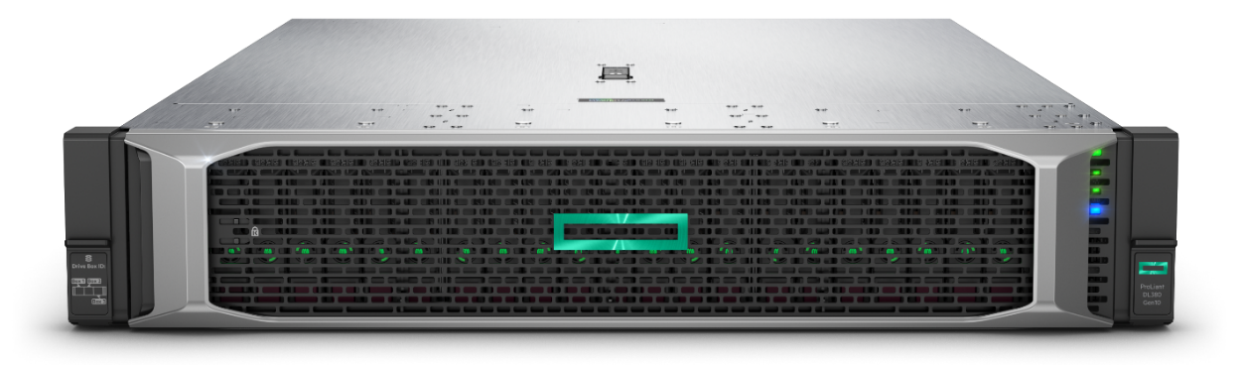
The premium standard for multi-workload environments
HPE ProLiant DL380 Gen10 Plus Server
Expansion of HPE’s best-selling 2U rack server family, accelerating application, storage and GPU capabilities via enhanced computing & I/O
Freedom to choose:
Gen10 Plus: Performance oriented
Gen10: Budget focus
Running in parallel throughout lifecycle.
Primary Jobs-to-be-Done/Workloads
In both virtualized and bare metal deployments:
Empower users to thrive/Apps (collaborative, content, business)
Extract knowledge from data/Data management
Accelerate insights to complex questions/ML & AI
Launch: 6-April-2021
Key Features/Benefits
Fully enables 3rd Gen Intel Xeon SP processor capabilities (cores, RAM, I/O, security)/Enhanced performance and security.
Double I/O bandwidth with PCIe Gen4/Faster connectivity to surrounding infrastructure.
Dramatically enhanced storage/Larger, faster& more resilient datasets:
  Bay count: SATA, SAS, NVMe
  Controller support: SATA, SATA/SAS & Tri-Mode
  NVMe SW RAID support: VROC/SR100i
Notes:
Running in parallel with Gen10 through lifecycle
3rd Gen Intel Xeon SP processors
Extends Gen10 capabilities: HW RAID (M.2, NVMe), SED support, unencumbered fw access, etc.
Improved balanced I/O capabilities (cards, NVMe SSDs)
Significantly improved NVMe SSD support: VROC/SR100i, up to 10 direct access drives, tri-mode controller support
Silicon Root of Trust, Advanced Security, Infosight and OneView key differentiators

Slide 28
HPE ProLiant DL380 Gen10 & Gen10 Plus features
Feature evolution (1/3)
 | HPE ProLiant DL380 Gen10 | HPE ProLiant DL380 Gen10 Plus
Compute | Up to (2) 2nd Generation Intel® Xeon® Processor SP family, up to 28 Cores Full stack (minus T processors) Up to (2) UPI links per CPU (Up to 10.4 GT/s) PCIe Gen3, up to eight (8) available slots; 48 lanes M.2 standard primary riser Basic balanced I/O capabilities (no South PCIe lines, no PCIe lane recovery) | Up to (2) 3rd Generation Intel® Xeon® Processor Scalable family, up to 40 Cores Full Stack (minus T & Q processors) UPI: up to (3) Links per CPU (Up to 11.2 GT/s) PCIe Gen4: Up to eight (8) available slots; 64 lanes (48 N + 16 S) No M.2 capable primary riser; Adapters to re-route PCIe lanes Improved balanced I/O capab. (16 S. PCIe lanes, PCIe lane recovery)
Memory | (24) DDR4, 6 ch. per socket, up to 2933MT/s (3.0 TB+ max) | (32) DDR4, 8 channels per socket, up to 3200 MT/s (6.0 TB+ max)
Persistent Memory | Up to 12 HPE Persistent Memory featuring Intel® Optane™ DC persistent memory (3TB max per socket depending on processor model) Or up to 12 NVDIMMs HPE Scalable Persistent memory (192GB max) | Up to 16 Intel® Optane™ Persistent Memory 200 series (4TB max per socket)
Storage | 12 lanes embedded 6Gb AHCI/RAID SATA HPE Smart Array S100i SW RAID Choice of HPE Smart Array Controllers for performance or additional features Optional M.2 capable primary riser | 14 lanes embedded 6Gb AHCI/RAID SATA Intel VROC & HPE Smart Storage SR100i with NVMe support Choice of storage controllers, including tri-mode options for performance or additional features Optional M.2 HW RAID1 OS boot device (NS204i-p) Optional FIPS NVMe drives
HDD/SSD | Smart Drives and Smart Carriers Max of 30 (24 front+6 rear) SATA/SAS SFF; up to 20 NVMe SSD Max of 19 (12 front+4 internal+3 rear) SATA/SAS LFF +2 SATA/SAS SFF NVMe U.2 SSD support; NVMe AIC, M.2 enablement & uFF options | HPE drives on Basic Carriers Max of 36 (24f + 8 int + 4r) SFF SATA/SAS; up to 32 NVMe SSDs* Max of 20 LFF (12 front+4 internal + 4 rear) SATA/SAS LFF NVMe U.2 & U.3 SSD support; NVMe AIC, M.2 enab. No uFF options Choice of drive cages/trays (bays, protocols, etc.)
■ Differences in Bold

Slide 29
HPE ProLiant DL380 Gen10 & Gen10 Plus features (continued)
Feature evolution (2/3)
 | HPE ProLiant DL380 Gen10 | HPE ProLiant DL380 Gen10 Plus
Networking | 4x1GbE embedded + Choice of FlexibleLOM + Standup | No embedded LOM. Choice of OCP 3.0 + Standup
VGA/Serial/USB/SD Ports | Front Display Port Opt, Rear VGA & Optional Serial, 5 USB 3.0, + 2 USB 2.0 optional, microSD & optl. RAID1 protected dual micro-SD. Front Management port and dedicated rear iLO port | Front Display Port Opt, Rear VGA & Optional Serial, 5 USB 3.0, + 2 USB 2.0 optional. Opt. for RAID1 protected dual micro-SD. Front Management port and dedicated rear iLO port
GPU Support | Up to Single/Double-Wide & Active/Passive up to 10.5” (7/3) | Up to Single/Double-Wide & Active/Passive up to 10.5” (8/3)
BIOS | Legacy & UEFI modes | Legacy & UEFI modes
Management—Embedded | HPE iLO 5, SUM, RESTful Interface Tool | HPE iLO 5, SUM, RESTful Interface Tool
Power & Cooling | Up to 96% eff. To 1600W | Up to 96% efficiency to 1600W; 1000W Low-Line 96% efficient
Industry Compliance | ASHRAE A3 & A4, lower idle power, Energy Star | ASHRAE A3 & A4, lower idle power, Energy Star
Chassis | Eight variations (8 LFF/12 LFF/8 SFF/24 SFF) w/ LOM (emb./NC) variants TAA Trigger SKU (applying to all chassis as of 9/8/2020) Depth: 26.75” (SFF), 28.75” (LFF) | Four Network Choice (NC) variations: 8 LFF/12 LFF/8 SFF/24 SFF TAA via feature code Depth: 28.0” (SFF), 29.5” (LFF)
Security | Silicon Root of Trust from HPE Optional Chassis Intrusion Detection Kit Optional TPM Module Optional Bezel Lock Kit | Silicon Root of Trust from HPE Optional Chassis Intrusion Detection Kit TPM Module by default Optional Bezel Lock Kit Trusted Supply Chain (DL380T) Trigger SKU
■ Differences in Bold

Slide 30
HPE ProLiant DL380 Gen10 & Gen10 Plus features (continued)
Feature evolution (3/3)
 | HPE ProLiant DL380 Gen10 | HPE ProLiant DL380 Gen10 Plus
Serviceability | Easy Install and Ball Bearing Rail Kits Cable Management Arm (optional) | Easy Install Rail Kit Cable Management Arm (optional)
Warranty | 3/3/3 | 3/3/3
Operational Services | HPE Foundation Care HPE Proactive Care | HPE Pointnext Tech Care
■ Differences in Bold

Slide 31
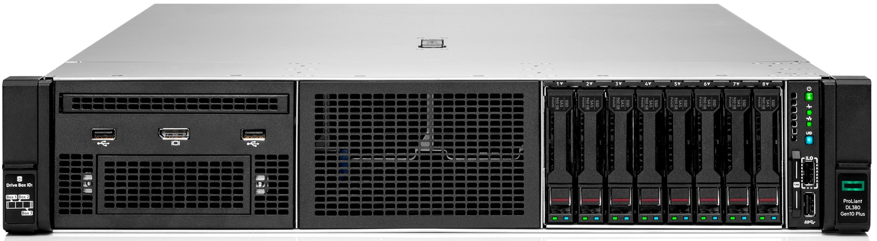
HPE ProLiant DL380 Gen10 plus Server
8 SFF Front of system detail
4
5
6
7
8
3
9
10
2
11
1
12
13
17
16
15
14
1. | Drive support label | 8 | Power On/Standby button and system power LED
2. | Optional USB 2.0 (via Universal Media Bay) | 9. | Health LED
3. | Optional front display port (Via Universal Media Bay) | 10. | NIC status LED
4. | Universal Media Bay (optional): | 11. | UID button/LED
 | Shown: Optical drive bay + Display port & USB 2.0 port kit | 12. | iLO Service Port
 | Option: +2 SFF 12G x1 SAS/SATA cage | 13. | USB 3.0
 | Option: +2 SFF 24G x4 Tri-Mode U.3 cage | 14. | Serial number label pull tab
5. | Quick removal access panel | 15. | Box 3
6. | Optional 8 SFF Drive Cage Bay | 16. | Box 2
7. | 8 SFF Drive Cage Bay | 17. | Box 1

Slide 32
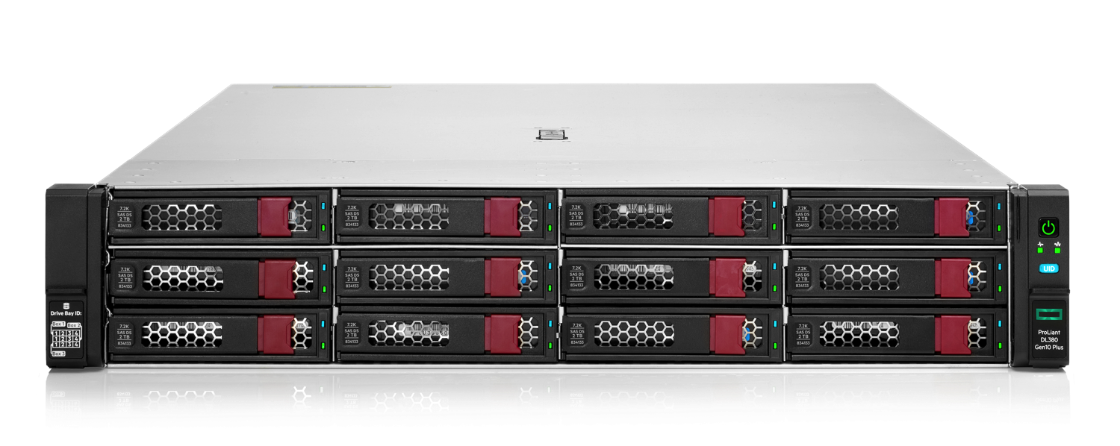
HPE ProLiant DL380 Gen10 plus Server (continued)
12 LFF Front of system detail
3
4
5
2
6
7
1
1. | Drive support label
2. | Quick removal access panel
3. | 12 LFF Drive Cage Bays
4. | Power On/Standby button and system power LED
5. | Health LED
6. | NIC Status
7. | UID Button

Slide 33
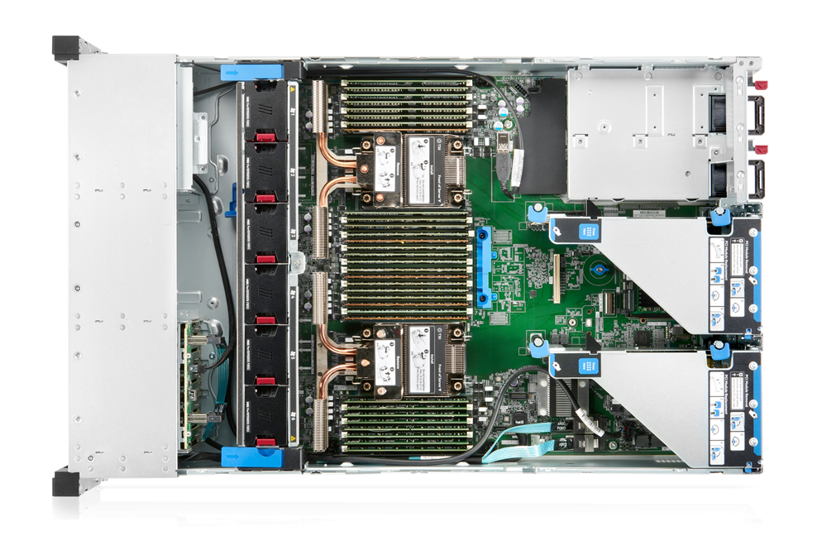
HPE ProLiant DL380 Gen10 plus Server (continued)
Interior of system detail
4
5
6
7
1. | Hot plug fans (6 single rotor standard)
 | High performance temperature fans optional
2. | 2 Processors, heatsink showing
3. | DDR DIMM Slots. Shown fully populated in 32 slots (16 per processor)
4. | AROC Connectors
5. | Hot Plug redundant HPE Flexible Slot Power supplies
6. | Secondary Riser, requires second CPU (Optional)
7. | Primary Riser
3
2
1

Slide 34
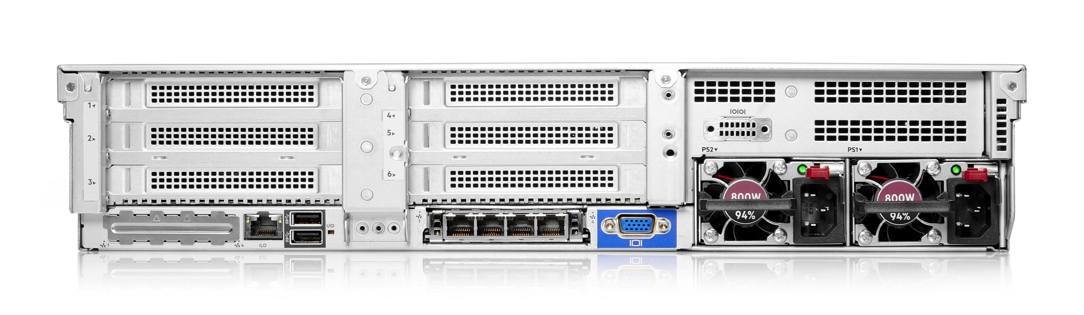
HPE ProLiant DL380 Gen10 plus Server (continued)
Rear view of system detail
1
2
3
4
10
9
8
7
6
5
1. | Primary Riser PCIe 4.0 slots | 6. | VGA port
2. | Secondary Riser PCIe 4.0 slots | 7. | OCP NIC ports (if equipped)
3. | Serial port (optional) |  | 200GbE through 1GbE options
4. | Power Supply 1 | 8. | USB 3.0 Ports (2)
5. | Power Supply 2 | 9. | iLO Management Port
 |  | 10. | Blank cover, not available for use

Slide 35
HPE ProLiant DL380 Gen10 plus Server (replaced controllers)
Pre-Configured Models
Feature | P55248-xx1 | P55247-xx1 | P55246-xx1 | P55245-xx1 | P55244-xx1
Localization | -B21 (WW) & -291 (Japan) | -B21 (WW) & -291 (Japan) | -B21 (WW) & -291 (Japan) | -B21 (WW) & -291 (Japan) | -B21 (WW) & -291 (Japan)
Proc Model | 5315Y (8 core, 3.2GHz, 140W) | 4314 (16 core, 2.4GHz, 135W) | 4310 (12 core, 2.1GHz, 120W) | 4309Y (8 core, 2.8GHz, 105W) | 4309Y (8 core, 2.8GHz, 105W)
Heatsink | Standard Heat Sink | Standard Heat Sink | Standard Heat Sink | Standard Heat Sink | Standard Heat Sink
Fan | 6 – Performance | 6 – Performance | 6 – Performance | 6 – Performance | 4 – Standard
Number of Procs | 1 | 1 | 1 | 1 | 1
Proc Spec | 8 core, 3.2GHz, 140W | 16 core, 2.4GHz, 135W | 12 core, 2.1GHz, 120W | 8 core, 2.8GHz, 105W | 8 core, 2.8GHz, 105W
Memory | 32GB (1 x 32GB DIMM) | 32GB (1 x 32GB DIMM) | 32GB (1 x 32GB DIMM) | 32GB (1 x 32GB DIMM) | 32GB (1 x 32GB DIMM)
Storage Controller | Broadcom MR416i-p | Broadcom MR416i-p | Broadcom MR416i-p | Broadcom MR416i-p | HPE SR100i Gen10 Plus FIO Software RAID
Smart Storage Battery | 96W Smart Storage Battery | 96W Smart Storage Battery | 96W Smart Storage Battery | 96W Smart Storage Battery | N/A
Backplane | 8SFF x1 U.3 tri-mode | 8SFF x1 U.3 tri-mode | 8SFF x1 U.3 tri-mode | 8SFF x1 U.3 tri-mode | 8SFF SAS/SATA
HDD | N/A | N/A | N/A | N/A | N/A
NIC | Broadcom BCM57412 Ethernet 10Gb 2-port SFP+ OCP3 | Broadcom BCM57412 Ethernet 10Gb 2-port SFP+ OCP3 | Broadcom BCM57412 Ethernet 10Gb 2-port SFP+ OCP3 | Broadcom BCM57412 Ethernet 10Gb 2-port SFP+ OCP3 | Broadcom BCM57412 Ethernet 10Gb 2-port SFP+ OCP3
Management | iLO 5 | iLO 5 | iLO 5 | iLO 5 | iLO 5
Power Supply | 800W Flex Slot Platinum Hot Plug Low Halogen | 800W Flex Slot Platinum Hot Plug Low Halogen | 800W Flex Slot Platinum Hot Plug Low Halogen | 800W Flex Slot Platinum Hot Plug Low Halogen | 800W Flex Slot Platinum Hot Plug Low Halogen
Expansion Slots | 8 | 8 | 8 | 8 | 8
ODD | Available option | Available option | Available option | Available option | Available option
Security | TPM Module | TPM Module | TPM Module | TPM Module | TPM Module
Rail Kit | 2U SFF Easy Install Rail Kit | 2U SFF Easy Install Rail Kit | 2U SFF Easy Install Rail Kit | 2U SFF Easy Install Rail Kit | 2U SFF Easy Install Rail Kit
SID | Optional | Optional | Optional | Optional | Optional
Universal Media Bay | Optional | Optional | Optional | Optional | Optional
Warranty | 3/3/3 | 3/3/3 | 3/3/3 | 3/3/3 | 3/3/3

Slide 36
HPE ProLiant DL380 Gen10 plus Server (EU Lot 9 configs)
Pre-Configured Models
Feature | P55281-421 | P55280-421 | P55279-421 | P55278-421 | P55277-421
Localization | EU Lot 9 | EU Lot 9 | EU Lot 9 | EU Lot 9 | EU Lot 9
Proc Model | 5315Y (8 core, 3.2GHz, 140W) | 4314 (16 core, 2.4GHz, 135W) | 4310 (12 core, 2.1GHz, 120W) | 4309Y (8 core, 2.8GHz, 105W) | 4309Y (8 core, 2.8GHz, 105W)
Heatsink | Standard Heat Sink | Standard Heat Sink | Standard Heat Sink | Standard Heat Sink | Standard Heat Sink
Fan | 6 – Performance | 6 – Performance | 6 – Performance | 6 – Performance | 4 – Standard
Number of Procs | 1 | 1 | 1 | 1 | 1
Proc Spec | 8 core, 3.2GHz, 140W | 16 core, 2.4GHz, 135W | 12 core, 2.1GHz, 120W | 8 core, 2.8GHz, 105W | 8 core, 2.8GHz, 105W
Memory | 32GB (1 x 32GB DIMM) | 32GB (1 x 32GB DIMM) | 32GB (1 x 32GB DIMM) | 32GB (1 x 32GB DIMM) | 32GB (1 x 32GB DIMM)
Storage Controller | Broadcom MR416i-p | Broadcom MR416i-p | Broadcom MR416i-p | Broadcom MR416i-p | HPE SR100i Gen10 Plus FIO Software RAID
Smart Storage Battery | 96W Smart Storage Battery | 96W Smart Storage Battery | 96W Smart Storage Battery | 96W Smart Storage Battery | N/A
Backplane | 8SFF x1 U.3 tri-mode | 8SFF x1 U.3 tri-mode | 8SFF x1 U.3 tri-mode | 8SFF x1 U.3 tri-mode | 8SFF SAS/SATA
HDD | N/A | N/A | N/A | N/A | N/A
NIC | Broadcom BCM57412 Ethernet 10Gb 2-port SFP+ OCP3 | Broadcom BCM57412 Ethernet 10Gb 2-port SFP+ OCP3 | Broadcom BCM57412 Ethernet 10Gb 2-port SFP+ OCP3 | Broadcom BCM57412 Ethernet 10Gb 2-port SFP+ OCP3 | Broadcom BCM57412 Ethernet 10Gb 2-port SFP+ OCP3
Management | iLO 5 | iLO 5 | iLO 5 | iLO 5 | iLO 5
Power Supply | 800W Flex Slot Titanium Hot Plug Low Halogen | 800W Flex Slot Titanium Hot Plug Low Halogen | 800W Flex Slot Titanium Hot Plug Low Halogen | 800W Flex Slot Titanium Hot Plug Low Halogen | 800W Flex Slot Titanium Hot Plug Low Halogen
Expansion Slots | 8 | 8 | 8 | 8 | 8
ODD | Available option | Available option | Available option | Available option | Available option
Security | TPM Module | TPM Module | TPM Module | TPM Module | TPM Module
Rail Kit | 2U SFF Easy Install Rail Kit | 2U SFF Easy Install Rail Kit | 2U SFF Easy Install Rail Kit | 2U SFF Easy Install Rail Kit | 2U SFF Easy Install Rail Kit
SID | Optional | Optional | Optional | Optional | Optional
Universal Media Bay | Optional | Optional | Optional | Optional | Optional
Warranty | 3/3/3 | 3/3/3 | 3/3/3 | 3/3/3 | 3/3/3

Slide 37
HPE ProLiant DL380 Gen10 plus Server (continued)
CTO Servers
Category | SKU | Product Description
CTO Servers | P05172-B21 | HPE ProLiant DL380 Gen10 Plus 8SFF NC CTO Server
 | P05173-B21 | HPE ProLiant DL380 Gen10 Plus 24SFF NC CTO Server
 | P05174-B21 | HPE ProLiant DL380 Gen10 Plus 12LFF NC CTO Server
 | P05175-B21 | HPE ProLiant DL380 Gen10 Plus 8LFF NC CTO Server
CTO Servers (TAA compliant) | P05172-B21 #GTA | HPE ProLiant DL380 Gen10 Plus 8SFF NC CTO Server
 | P05173-B21 #GTA | HPE ProLiant DL380 Gen10 Plus 24SFF NC CTO Server
 | P05174-B21 #GTA | HPE ProLiant DL380 Gen10 Plus 12LFF NC CTO Server
 | P05175-B21 #GTA | HPE ProLiant DL380 Gen10 Plus 8LFF NC CTO Server

Slide 38
HPE ProLiant DL380 Gen10 plus Server (continued)
Server Unique Options
Category | SKU | Product Description | 8 SFF | 12 LFF
Cooling | P27095-B21 | HPE ProLiant DL380 Gen10 Plus High-Performance Heat Sink Kit | ✓ | ✓
 | P37034-B21 | HPE ProLiant DL380 Gen10 Plus Standard Heat Sink Kit | ✓ | ✓
 | P37042-B21 | HPE ProLiant DL300 Gen10 Plus Standard Fan Kit | ✓ | ✓
 | P14608-B21 | HPE ProLiant DL36X Gen10 Plus High-Performance Fan Kit | ✓ | ✓
Drive cages | P25903-B21 | HPE DL38X Gen10 Plus 2LFF Low Profile Secondary Riser Kit | N/A | ✓
 | P26922-B21 | HPE ProLiant DL38X Gen10 Plus 2SFF x4 Tri-Mode 24G U.3 BC Front/Tertiary Drive Cage Kit | ✓ | ✓
 | P26924-B21 | HPE ProLiant DL300 Gen10 Plus 2U 2SFF x4 Tri-Mode 24G U.3 BC Side-by-Side Drive Cage Kit (8 LFF Servers Only) | N/A | ✓
 | P26930-B21 | HPE ProLiant DL300 Gen10 Plus 2U 8SFF SAS/SATA 12G BC Front Bay 1/2 Drive Cage Kit | ✓ | N/A
 | P26931-B21 | HPE ProLiant DL300 Gen10 Plus 2U 8SFF x4 Tri-Mode 24G U.3 BC Front Drive Cage Kit | ✓ | N/A
 | P26932-B21 | HPE ProLiant DL300 Gen10 Plus 2U 8SFF x4 NVMe 16G U.2 BC Front Drive Cage Kit | ✓ | N/A
 | P27194-B21 | HPE ProLiant DL300 Gen10 Plus 2U 8SFF x1 Tri-Mode 24G U.3 BC Front Drive Cage Kit | ✓ | N/A
 | P14579-B21 | HPE DL38X Gen10 Plus 2LFF Primary FIO Riser Kit | ✓ | ✓
For a full range of supported options please see QuickSpecs

Slide 39
HPE ProLiant DL380 Gen10 plus Server (continued)
Server Unique Options
Category | SKU | Product Description | 8 SFF | 12 LFF
Drive cages | P14580-B21 | HPE DL38X Gen10 Plus 2LFF Tertiary FIO Riser Kit (8 LFF Servers Only) | N/A | ✓
 | P14609-B21 | HPE DL38X Gen10 Plus Universal Media Bay Kit | ✓ | ✓
 | P26919-B21 | HPE ProLiant DL38X Gen10 Plus 4LFF SAS/SATA 12G LP Midplane Drive Cage Kit | N/A | ✓
 | P26920-B21 | HPE ProLiant DL380 Gen10 Plus 2SFF SAS/SATA 12G BC x16 Slot 3 Primary/Secondary Riser Kit | ✓ | ✓
 | P26923-B21 | HPE ProLiant DL380 Gen10 Plus 2SFF SAS/SATA 12G BC Front/Tertiary Stackable Drive Cage Kit | ✓ | ✓
 | P26925-B21 | HPE ProLiant DL300 Gen10 Plus 2U 2SFF SAS/SATA 12G BC Side-by-Side Drive Cage Kit (8 LFF Servers Only) | N/A | ✓
 | P27193-B21 | HPE ProLiant DL38X Gen10 Plus 8SFF x1 Tri-Mode 24G U.3 BC Midplane Drive Cage Kit | ✓ | ✓
 | P39769-B21 | HPE ProLiant DL300 Gen10 Plus 2U 8SFF x4 Tri-Mode 24G U.3 BC Midplane Drive Cage Kit | ✓ | ✓
For a full range of supported options please see QuickSpecs

Slide 40
HPE ProLiant DL380 Gen10 plus Server (continued)
Server Unique Options
Category | SKU | Product Description | 8 SFF | 12 LFF
Riser Cards | P38771-B21 | HPE DL385 Gen10 Plus Primary/Secondary Riser Cage without Retainer Clip | ✓ | ✓
 | P38774-B21 | HPE DL385 Gen10 Plus Tertiary Riser Cage without Retainer Clip | ✓ | ✓
 | P14575-B21 | HPE DL38X Gen10 Plus Primary NEBS-compliant Riser Kit | ✓ | ✓
 | P14577-B21 | HPE DL38X Gen10 Plus Tertiary NEBS-compliant Riser Kit | ✓ | ✓
 | P14581-B21 | HPE DL38X Gen10 Plus x8/x8 Tertiary Riser Kit | ✓ | ✓
 | P14587-B21 | HPE DL38X Gen10 Plus x8/x16/x8 Secondary Riser Kit | ✓ | ✓
 | P14588-B21 | HPE DL38X Gen10 Plus x16 Tertiary Riser Kit | ✓ | ✓
 | P14589-B21 | HPE DL38X Gen10 Plus x16/x16 Slot 1/2 Secondary Riser Kit | ✓ | ✓
 | P14590-B21 | HPE DL38X Gen10 Plus x16/x16 Slot 2/3 Secondary Riser Kit | ✓ | ✓
 | P14592-B21 | HPE DL38X Gen10 Plus x16/x16 Slot 1/2 FIO Riser Kit | ✓ | ✓
For a full range of supported options please see QuickSpecs

Slide 41
HPE ProLiant DL380 Gen10 plus Server (continued)
Server Unique Options
Category | SKU | Product Description | 8 SFF | 12 LFF
Riser Cards | P14599-B21 | HPE DL38X Gen10 Plus x16/x16 Slot 2/3 FIO Riser Kit | ✓ | ✓
 | P14600-B21 | HPE DL38X Gen10 Plus Slot1 x16 Adder for Slot2/3 Riser Kit | ✓ | ✓
 | P27089-B21 | HPE ProLiant DL380 Gen10 Plus 2-port 4NVMe x16 SlimSAS Secondary Riser Kit | ✓ | ✓
 | P27090-B21 | HPE ProLiant DL380 Gen10 Plus 2-port 4NVMe x16 SlimSAS Primary Riser Kit | ✓ | ✓
 | P27091-B21 | HPE ProLiant DL380 Gen10 Plus 3-port 6NVMe x8 SlimSAS Primary Riser Kit | ✓ | ✓
 | P27092-B21 | HPE ProLiant DL380 Gen10 Plus 4-port 8NVMe SlimSAS Primary Riser Kit | ✓ | ✓
 | P27093-B21 | HPE ProLiant DL380 Gen10 Plus 2-port 4NVMe SlimSAS Tertiary Riser Kit | ✓ | ✓
 | P35416-B21 | HPE ProLiant DL380 Gen10 Plus 3-port 6NVMe x8 SlimSAS Secondary Riser Kit | ✓ | ✓
 | P35417-B21 | HPE ProLiant DL380 Gen10 Plus 4-port 8NVMe SlimSAS Secondary Riser Kit | ✓ | ✓
 | P37038-B21 | HPE ProLiant DL380 Gen10 Plus x8/x16/x8 Primary FIO Riser Kit | ✓ | ✓
For a full range of supported options please see QuickSpecs

Slide 42
HPE ProLiant DL380 Gen10 plus Server (continued)
Server Unique Options
Category | SKU | Product Description | 8 SFF | 12 LFF
Rails | P22018-B21 | HPE DL38X Gen10 Plus 2U SFF Easy Install Rail Kit | ✓ | N/A
 | P22019-B21 | HPE DL38X Gen10 Plus 2U LFF Easy Install Rail Kit | N/A | ✓
 | P22020-B21 | HPE DL38X Gen10 Plus 2U Cable Management Arm for Rail Kit | ✓ | ✓
Serial port | P14606-B21 | HPE ProLiant DL38X Gen10 Plus Rear Serial Port Cable Kit | ✓ | ✓
Systems Insight Display | P27096-B21 | HPE ProLiant DL380 Gen10 Plus SFF Systems Insight Display Kit | ✓ | ✓
For a full range of supported options please see QuickSpecs

Slide 43
3rd Generation intel Xeon scalable processors

Slide 44
3rd Generation Intel® xeon® scalable processor summary
Pervasive performance
Next Gen platform
Built-in AI & Security
Architectural, process technology and platform innovations
  Performance, security and operational efficiency
  10nm+ process technology
Up to 18% higher IPC
  vs. 2nd Generation Intel Xeon-SP
Support for three Intel UPI links
Whitley platform supporting two-socket system design
  PCIe Gen4
  8-channel DDR4/3200 (2 DPC)
1.60X Memory bandwidth
  vs. 2nd Generation Intel Xeon-SP
Supports Intel Optane Persistent Memory 200 series
New Hardware-enhanced security
  Crypto new instructions
  Intel Total Memory Encryption
  Intel Software Guard Extensions
  Intel Total Memory Encryption
Enhanced built-in acceleration
  With crypto-NI
  Intel Deep Learning boost
Source: Intel 3rd Generation Xeon Scalable Processors Disclosure Guidelines—What’s Public

Slide 45
Intel® xeon® scalable processors GENERATION COMPARISON
Category | Xeon Scalable Processors | 2nd Gen Xeon Scalable Processors | 3rd Gen Xeon Scalable Processors
Socket | LGA-3647 | LGA-3647 | LGA-4189
Process | 14nm | 14nm | 10nm
Cores | 4–28 | 4–28 | 8–40
Max L3 Cache Size | 38.5MB | 38.5MB | 60MB
Memory | 6ch DDR4-2666 MT/s | 6ch DDR4-2933 MT/s | 8ch DDR4-3200 MT/s
PCIe Tech & Lane Count | PCIe Gen3, 48L/Socket | PCIe Gen3, 48L/Socket | PCIe Gen4, 64L/Socket
Persistent Memory | Not supported | 100 series | 200 series
Chipset | C621 | C621 | C621A
Power | 70W–205W | 70W–205W | 105W–270W

Slide 46
3rd Generation Intel xeon scalable processors
XCC die CPUs stack
Intel Xeon Models | CPU Frequency | Cores | L3 Cache | Power | UPI | DDR4 | SGX Enclave size | Max. Memory
Platinum 8380 | 2.3 GHz | 40 | 60 MB | 270W | 3 @ 11.2 GT/s | 3200 MT/s | 512GB | 6TB
Platinum 8368 | 2.4 GHz | 38 | 57 MB | 270W | 3 @ 11.2 GT/s | 3200 MT/s | 512GB | 6TB
Platinum 8360Y | 2.4 GHz/2.5 GHz/2.6 GHz | 36/32/24 | 54 MB | 250W/250W/220W | 3 @ 11.2 GT/s | 3200 MT/s | 64GB | 6TB
Platinum 8358P¹ | 2.6 GHz | 32 | 48 MB | 240W | 3 @ 11.2 GT/s | 3200 MT/s | 8GB | 6TB
Platinum 8358 | 2.6 GHz | 32 | 48 MB | 250W | 3 @ 11.2 GT/s | 3200 MT/s | 64GB | 6TB
Platinum 8352Y | 2.2 GHz/2.3 GHz/2.6 GHz | 32/24/16 | 48 MB | 205W/185W/185W | 3 @ 11.2 GT/s | 3200 MT/s | 64GB | 6TB
Platinum 8352V^{1,2} | 2.1 GHz/2.0 GHz/2.0 GHz | 36/32/24 | 54 MB | 195W/180W/155W | 3 @ 11.2 GT/s | 2933 MT/s | 8GB | 6TB
Platinum 8352S² | 2.2 GHz/2.3 GHz/2.6 GHz | 32/24/16 | 48 MB | 205W/185W/185W | 3 @ 11.2 GT/s | 3200 MT/s | 512GB | 6TB
Platinum 8351N³ | 2.4 GHz | 36 | 54 MB | 225W | N/A | 2933 MT/s | 64GB | 6TB
Gold 6354 | 3.0 GHz | 18 | 39 MB | 205W | 3 @ 11.2 GT/s | 3200 MT/s | 64GB | 6TB
Gold 6348 | 2.6 GHz | 28 | 42 MB | 235W | 3 @ 11.2 GT/s | 3200 MT/s | 64GB | 6TB
Gold 6346 | 3.1 GHz | 16 | 36 MB | 205W | 3 @ 11.2 GT/s | 3200 MT/s | 64GB | 6TB
Gold 6338N⁴ | 2.2 GHz | 32 | 48 MB | 185W | 3 @ 11.2 GT/s | 2667 MT/s | 64GB | 6TB
Gold 6338 | 2.0 GHz | 32 | 48 MB | 205W | 3 @ 11.2 GT/s | 3200 MT/s | 64GB | 6TB
Gold 6330N⁴ | 2.2 GHz | 28 | 42 MB | 165W | 3 @ 11.2 GT/s | 2667 MT/s | 64GB | 6TB
Gold 6330 | 2.0 GHz | 28 | 42 MB | 205W | 3 @ 11.2 GT/s | 2933 MT/s | 64GB | 6TB
Gold 6314U⁵ | 2.3 GHz | 32 | 48 MB | 205W | N/A | 3200 MT/s | 64GB | 6TB
¹ Deterministic base frequency rating only applicable to VM workloads. Other workloads may see throttling;
² Supports Intel® Speed Select Performance Profile (SST-P), even though not being a “Y” processor;
³ Single socket capable even though not being a “U” processor. No dual socket support;
⁴ Deterministic base frequency rating only applicable for NFV workloads. Other workloads may see throttling;
⁵ Single socket capable, no dual socket support.
Bold: Speed Select Performance Profile processors default values.

Slide 47
3rd Generation Intel xeon scalable processors
HCC die CPUs stack
Intel Xeon Models | CPU Frequency | Cores | L3 Cache | Power | UPI | DDR4 | SGX Enclave size | Max. Memory
Gold 6342 | 2.8 GHz | 24 | 36 MB | 230W | 3 @ 11.2 GT/s | 3200 MT/s | 64GB | 6TB
Gold 6336Y | 2.4 GHz/2.9 GHz/3.1 GHz | 24/12/8 | 36 MB | 185W/150W/150W | 3 @ 11.2 GT/s | 3200 MT/s | 64GB | 6TB
Gold 6334 | 3.6 GHz | 8 | 18 MB | 165W | 3 @ 11.2 GT/s | 3200 MT/s | 64GB | 6TB
Gold 6326 | 2.9 GHz | 16 | 24 MB | 185W | 3 @ 11.2 GT/s | 3200 MT/s | 64GB | 6TB
Gold 6312U³ | 2.4 GHz | 24 | 36 MB | 185W | N/A | 3200 MT/s | 64GB | 6TB
Gold 5320 | 2.2 GHz | 26 | 39 MB | 185W | 3 @ 11.2 GT/s | 2933 MT/s | 64GB | 6TB
Gold 5318Y | 2.1 GHz/1.9GHz/2.0GHz | 24/24/22 | 36 MB | 165W/150W/150W | 3 @ 11.2 GT/s | 2933 MT/s | 64GB | 6TB
Gold 5318S¹ | 2.1 GHz/1.9GHz/2.0GHz | 24/24/22 | 36 MB | 165W/150W/150W | 3 @ 11.2 GT/s | 2933 MT/s | 512GB | 6TB
Gold 5318N^{1,2} | 2.1 GHz/2.0GHz | 24/20 | 36 MB | 150W/135W | 3 @ 11.2 GT/s | 2667 MT/s | 64GB | 6TB
Gold 5317 | 3.0 GHz | 12 | 18 MB | 150W | 3 @ 11.2 GT/s | 2933 MT/s | 64GB | 6TB
Gold 5315Y | 3.2 GHz/3.2GHz/3.4GHz | 8/6/4 | 12 MB | 140W/125W/115W | 3 @ 11.2 GT/s | 2933 MT/s | 64GB | 6TB
Silver 4316 | 2.3 GHz | 20 | 30 MB | 150W | 2 @ 10.4 GT/s | 2667 MT/s | 8GB | 6TB
Silver 4314 | 2.4 GHz | 16 | 24 MB | 135W | 2 @ 10.4 GT/s | 2667 MT/s | 8GB | 6TB
Silver 4310 | 2.1 GHz | 12 | 18 MB | 120W | 2 @ 10.4 GT/s | 2667 MT/s | 8GB | 6TB
Silver 4309Y | 2.8 GHz/2.6GHz/2.3GHz | 8/8/8 | 12 MB | 105W/95W/85W | 2 @ 10.4 GT/s | 2667 MT/s | 8GB | 6TB
¹ Supports Intel® Speed Select Performance Profile (SST-P), even though not being a “Y” processor;
² Deterministic base frequency rating only applicable for NFV workloads. Other workloads may see throttling;
³ Single socket capable, no dual socket support.
Bold: Speed Select Performance Profile processors default values.

Slide 48
3rd Generation Intel xeon scalable processors
Post-TTM CPUs stack
Intel Xeon Models | CPU Frequency | Cores | L3 Cache | Power | UPI | DDR4 | SGX Enclave size | Max. Memory
Platinum 8362¹ | 2.8 GHz | 32 | 48 MB | 265W | 3 @ 11.2 GT/s | 3200 MT/s | 64GB | 6TB
Platinum 8352M^{1,2} | 2.3 GHz/2.4 GHz/2.6 GHz | 32/28/24 | 48 MB | 185W/185W/185W | 3 @ 11.2 GT/s | 3200 MT/s | 64GB | 6TB
¹ Does not support Intel® Speed Select Technology - Base Frequency (SST-BF);
² Supports Intel® Speed Select Performance Profile (SST-P), even though not being a “Y” processor;
Bold: Speed Select Performance Profile processors default values.

Slide 49
HPE PROLIANT DL3x0 Gen10 Plus configuration highlights

Slide 50

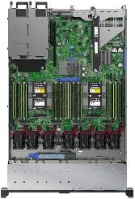



HPE PROLIANT DL3x0 Gen10 plus processor kit BOM transition
Now vs. future—CTO
Gen10 CTO
Gen10 Plus CTO
1P Installation
Processor (-B21)
1P Installation (-L21)
Processor
Heatsink
Heatsink (-B21)
2P Installation (-B21)
Processor
Heatsink
2 Fans
2P Installation
Processor (-B21)
Heatsinks (-B21)
Fan Kit (-B21)
1P Order:
#1 CTO server
#2 CPU + Heatsink kit (-L21) x 1
2P Order:
#1 CTO server
#2 CPU + Heatsink kit (-L21) x 1
#3 CPU + Heatsink + Fan kit (-B21) x 1
#4 Secondary/Tertiary Riser x 1
1P Order:
#1 CTO server
#2 Processor kit (-B21) x 1
#3 Heatsink kit (-B21) x 1
2P Order:
#1 CTO server
#2 Processor kit (-B21) x 2
#3 Heatsink kit (-B21) x 2
#4 Fan kit1 (-B21) x 1
□ Auto-defaulted via CTO rules—Correct HS added depending TDP (Standard vs. Performance)
¹ Except for High Performance fan kit, as includes 7 fans already (1P or 2P)

Slide 51
HPE PROliant DL3x0 Gen10 plus memory
Gen10 Plus DIMM population and Gen10 compare
DIMMs/socket | How to order | DIMM slot |  |  |  |  |  |  |  |  |  |  |  |  |  |  |  | DL3x0 Gen10 comparison
 |  | 1 | 2 | 3 | 4 | 5 | 6 | 7 | 8 | 9 | 10 | 11 | 12 | 13 | 14 | 15 | 16
1 DIMM | Default |  |  |  |  |  |  |  |  |  |  |  |  |  | 14 |  |  | Supported
2 DIMMs | Default |  |  | 3 |  |  |  |  |  |  |  |  |  |  | 14 |  |  | Supported
4 DIMMs | Default |  |  | 3 |  |  |  | 7 |  |  | 10 |  |  |  | 14 |  |  | Supported
6 DIMMs | Default | 1 |  | 3 |  |  |  | 7 |  |  | 10 |  |  |  | 14 |  | 16 | Supported
8 DIMMs | Default | 1 |  | 3 |  | 5 |  | 7 |  |  | 10 |  | 12 |  | 14 |  | 16 | Supported
12 DIMMs | Default¹ | 1 | 2 | 3 | 4 |  |  | 7 | 8 | 9 | 10 |  |  | 13 | 14 | 15 | 16 | Supported
12 DIMMs | Trigger SKU for Unbalanced SNC interleave² | 1 |  | 3 | 4 | 5 |  | 7 | 8 | 9 | 10 |  | 12 | 13 | 14 |  | 16 | Supported
16 DIMMs | Default | 1 | 2 | 3 | 4 | 5 | 6 | 7 | 8 | 9 | 10 | 11 | 12 | 13 | 14 | 15 | 16 | Not feasible—12 DIMMS max
¹ Supported for 6 way interleave, Sub-NUMA Clustering (SNC);
² Unbalanced, supported for SNC 2, 4/8 way interleave. Must order P26933-B21 [HPE 12 DIMM SNC2 Hemi SGX FIO Enable]
Notes:
Optimal memory performance is achieved when the system is configured with a fully homogeneous and balanced DIMM configuration. Unbalanced DIMM configurations are those in which the installed memory is not distributed evenly across the memory channels or the CPUs. Hewlett Packard Enterprise discourages unbalanced configurations because they will always have lower performance than similar balanced configurations. There is, however, one exception—when using Sub-NUMA clustering with DL360 Gen10 Plus or DL380 Gen10 Plus servers.
Sub-NUMA Clustering (SNC) divides the cores, cache, and memory of the processor into multiple NUMA domains. Enabling this option can increase performance for workloads that are NUMA aware and optimized.
An SNC creates two localization domains within a processor by mapping addresses from one of the local memory controllers in one half of the LLC slices closer to that memory controller and addresses mapped to the other memory controller into the LLC slices in the other half.
The memory population rules for HPE Gen10 Plus servers are noted on chart. Note that if populating with 12 DIMMs an unbalanced configuration is required for SNC using the population order referenced. Note that these population rules apply to each CPU within the server.

Slide 52
Hpe proliant DL3x0 Gen10 plus cooling
Heatsink, fan and DIMM blank requirements per processor Thermal Design Power (TDP) ranges
Increased processor TDP and DIMM count requires optimally cooling DL3x0 Gen10 Plus servers.
Three components will be available to efficiently address challenge:
  High performance heatsink, necessary for processors with a TDP equal or higher than 150W.
  High performance fans, required when processors with a TDP of 205W or more are being used.
    Other options as NVMe SSDs, 100GbE or greater NICs/HCAs, accelerators or 24G SAS drives require high performance fans..
  DIMM blanks, which are imperative for TDPs ranging 105W–140W and 230W–270W.
    Recommended for 150W to 255W TDPs—both included—as could assist lowering fan speed/noise given funneling air the best way.
    Same kit currently used on DL38x Gen10 & DL385 Gen10 Plus (P07818-B21), BTO includes 31 dummy blanks.
  Table below summarizes applicable TDP scenarios:
CPU TDP (Watts) | 105W–140W | 150W–195W | 205W–225W | 230W–270W
Heatsink | Standard | High Performance | High Performance | High Performance
Fans | Standard | Standard | High Performance | High Performance
DIMM blanks | Required | Recommended¹ | Recommended¹ | Required
Bold: Required; ¹ Optional DIMM blanks enhance cooling and could reduce fan speed/noise. Not enforced by processor TDP rules.

Slide 53
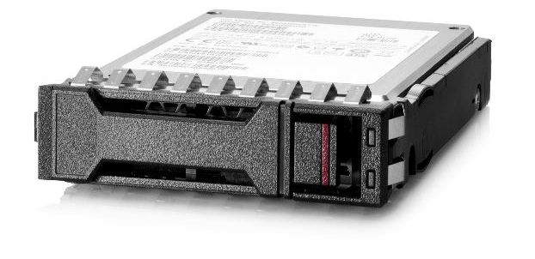
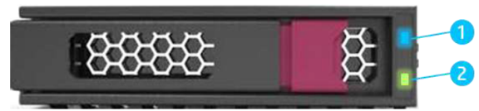
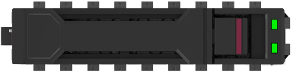

Hpe proliant DL3x0 Gen10 PLUS drive carriers
1
2
1
LFF = LPC
SFF = BC
2
Item | LED | Status | Definition
 | Fault/ Locate | Solid amber | The drive has failed, unsupported or invalid.
 |  | Solid blue | The drive is operating normally and being identified by a management application.
 |  | Flashing amber/blue (1Hz) | The drive has failed, or a predictive failure alert has been received for this drive; it has also been identified by a management application.
 |  | Flashing amber (1Hz) | A predictive failure alert has been received for this drive. Replace the drive as soon as possible.
 | Online/Activity | Solid green | The drive is online and has no activity.
 |  | Flashing green (4Hz) | The drive is operating normally and has activity.
 |  | Flashing green (1Hz) | The drive is rebuilding, RAID migration, stripe size migration, capacity expansion, logical drive extension, erasing or spare activation.
 |  | Off | The drive is not configured by a RAID controller or a spare drive.
1
2

Slide 54


Hpe proliant DL360 Gen10 Plus Backplanes
Backplane Type | Carrier | Drive¹ | Front
12G x1SAS UBM2 LP BP Segregated SAS or SATA Only Attach SR/MR Gen10/10+ RAID Attach ATA | LFF Low Profile | 12G SAS 6G SATA | (4)
12G x1SAS UBM2 BC BP Segregated SAS or SATA Only Attach SR/MR Gen10/10+ RAID Attach ATA | SFF Basic | 12G SAS 6G SATA | (8) and (2) in 2SFF SAS/SATA BC in Universal Media Bay
24G x1NVMe/SAS UBM3 BC BP Converged NVMe, SAS, or SATA Attach SR/MR Gen10/10+ RAID Attach ATA | SFF Basic | x1 U.3 NVMe 24G SAS 6G SATA | (8) and (2) in 2SFF x4 Tmode U.3 BC in Universal Media Bay
24G x4NVMe/SAS UBM3 BC BP Converged NVMe, SAS, or SATA Wide-SAS Attach SR/MR Gen10/10+ RAID Attach ATA Attach CPU | SFF Basic | x4 U.3 NVMe x2 U.3 NVMe 24G SAS 6G SATA | (8) and (2) in 2SFF x4 Tmode U.3 BC in Universal Media Bay (Note 2SFF x4, not x1)
16G x4NVMe UBM4 BC BP Segregated NVMe Only Attach SR/MR Gen10+ RAID Attach CPU | SFF Basic | x4 U.3 NVMe x4 U.2 NVMe | (8) and (2) in 2SFF x4 NVMe U.2 BC in Universal Media Bay
E
4LFF—SATA/SAS backplane included
E
A, a
A
B
C
D
4LFF
a
c
d
2SFF
8SFF—choice of optional backplanes
B
8SFF CTO server does not include any backplane.
Must be added if internal drive support needed.
C, c
D, d
¹ NVMe SSDs do not need to match backplane lane width (e.g., x4 drive can be installed on x1 backplane and vice versa), bandwidth will be determined by narrowest link

Slide 55
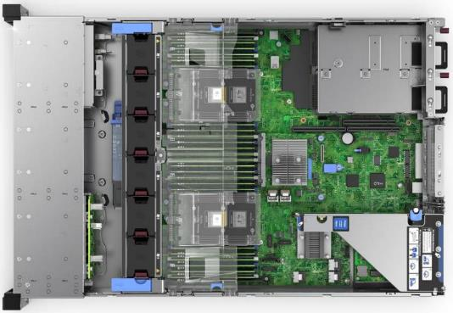
Hpe proliant DL380 Gen10 Plus Backplanes
Backplane Type | Carrier | Drive¹ | Front | Mid | Rear
12G x1SAS UBM2 LP BP Segregated SAS or SATA Only Attach SR/MR Gen10/10+ RAID Attach ATA | LFF Low Profile | 12G SAS 6G SATA | (12) or (8) with Media Bay | (4) | (2) Primary and/or (2) Secondary
12G x1SAS UBM2 BC BP Segregated SAS or SATA Only Attach SR/MR Gen10/10+ RAID Attach ATA | SFF Basic | 12G SAS 6G SATA | (8+8+8) and/or (2) in SFF Universal Media Bay or (2) in 8LFF Media Bay |  | (2) Primary and/or (2) Secondary and/or (2) Tertiary
24G x1NVMe/SAS UBM3 BC BP Converged NVMe, SAS, or SATA Attach SR/MR Gen10/10+ RAID Attach ATA | SFF Basic | x1 U.3 NVMe 24G SAS 6G SATA | (8+8+8) | (8)
24G x4NVMe/SAS UBM3 BC BP Converged NVMe, SAS, or SATA Wide-SAS Attach SR/MR Gen10/10+ RAID Attach ATA Attach CPU | SFF Basic | x4 U.3 NVMe x2 U.3 NVMe 24G SAS 6G SATA | (8+8+8) and/or (2) in SFF Universal Media Bay or (2) in 8LFF Media Bay | (8) | (2) Tertiary
16G x4NVMe UBM4 BC BP Segregated NVMe Only Attach SR/MR Gen10+ RAID Attach CPU | SFF Basic | x4 U.3 NVMe x4 U.2 NVMe | (8+8+8)
Front
Mid
Rear
Tertiary
Rear Secondary
Rear Primary
¹ NVMe SSDs do not need to match backplane lane width (e.g., x4 drive can be installed on x1 backplane and vice versa), bandwidth will be determined by narrowest link

Slide 56
Hpe proliant DL3x0 Gen10 PLUS NVIDIA gpu support plan
Platform | Jun’21 | Jul’21 | Aug’21 | Nov’21 | Dec’21
DL360 Gen10 Plus | T4 |  |  | RTX A4000
DL380 Gen10 Plus | A40 | A30 | A10 |  | A16
 | A100-40GB |  | T4 | RTX A4000

Slide 57
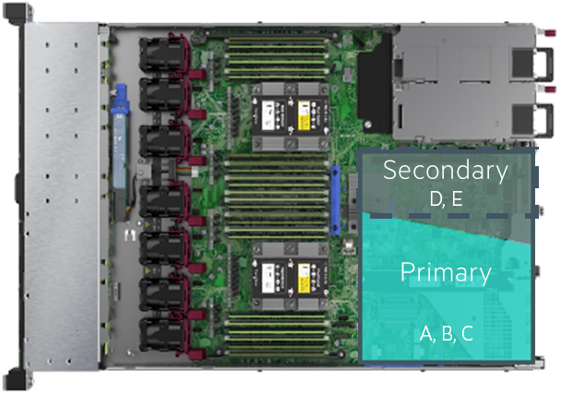
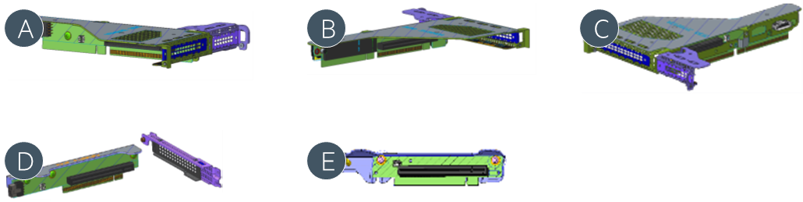
Hpe proliant DL360 Gen10 Plus riser options
Key | Part number | Description | Field Inst.¹ | Riser position |  | Slot Gen4 lanes) |  |  |  | GPU support | NVMe |  | M.2 connector
 |  |  |  | Prim.² | Sec.³ | Slots | #1 | #2 | #3
 |  |  |  |  |  |  |  |  |  |  | Connectors | SSDs
A | n/a | HPE ProLiant DL36X Gen10+ x16/x16 Primary GPU Riser⁴ |  | D |  | 2 | x16⁵ | x16⁶ |  | Y¹¹
B | P26463-B21 | HPE ProLiant DL36X Gen10+ x16/x8 PCIe M.2 NS204i-r Riser Kit | Y | O |  | 2 | x16⁵ | x8⁶ |  | Y¹¹ |  |  | 2¹⁰
C | P26465-B21 | HPE ProLiant DL36X Gen10 Plus 8SFF 2NVMe CPU1 Riser Kit^{4, 7} | Y | O |  | 2 | x16⁵ | x8⁶ |  | Y¹¹ | 1 | 2
D | P26467-B21 | HPE ProLiant DL36X Gen10 Plus Full Height Riser Kit^{4, 8} | Y |  | O | 1 |  | n/a⁹ | x16⁵ | Y¹¹
E | P26471-B21 | HPE ProLiant DL36X Gen10 Plus Low Profile Riser Kit | Y |  | O | 1 |  |  | x16⁶ | N¹¹
Y = Yes; D = Default; O = Optional; Gray = Not supported or slot/connector not present |  |  |  |  | ⁴ Features AUX power connector |  |  |  |  | ⁹ When secondary full height riser is installed, then primary PCIe
 |  |  |  |  | ⁵ Full Height |  |  |  |  | slot #2 cannot be used. Only two full height slots are supported
¹ Suitable for field installation (BTO) and factory integration (0D1) |  |  |  |  | ⁶ Low Profile |  |  |  |  | ¹⁰ Media not included, 22110 capable.
² Connected to socket #1 |  |  |  |  | ⁷ Not supported on 4LFF servers |  |  |  |  | ¹¹ GPU max 75W
³ Connected to socket #2, requires 2 processors |  |  |  |  | ⁸ Includes cabling
A
B
C
D
E

Slide 58
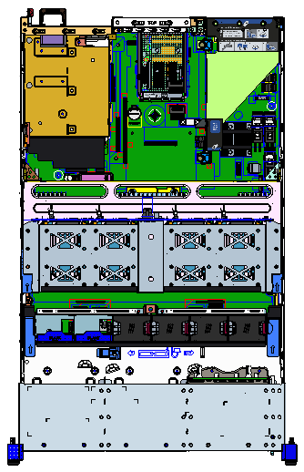
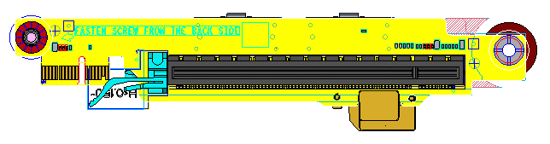
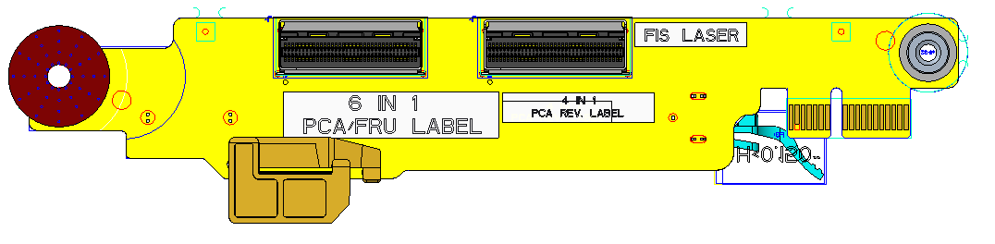
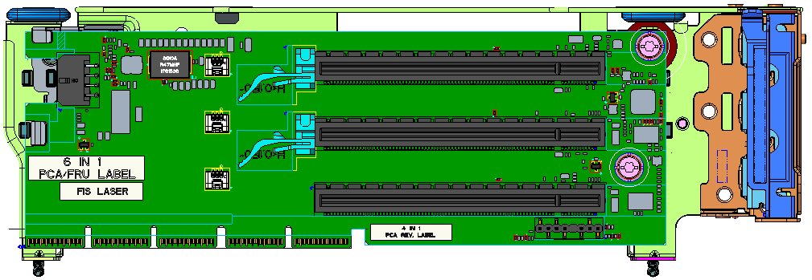
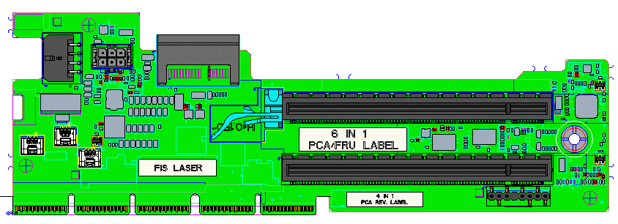
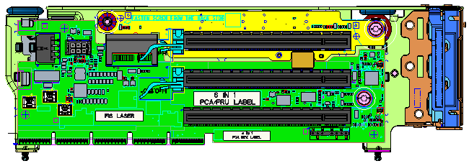
Hpe proliant DL380 Gen10 Plus riser options
Y = Yes; D = Default; O = Optional; Gray = Not supported or slot/connector not present
A
C
C
B
Teritary
E,F,J,O
B
C
Secondary
A,B,C,C+D,G,H,I,K,L,N,O
Primary
A,B,C,C+D,G,H,I,K,M

Slide 59
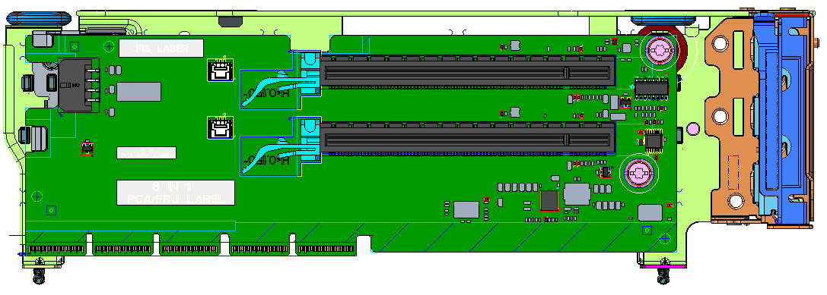
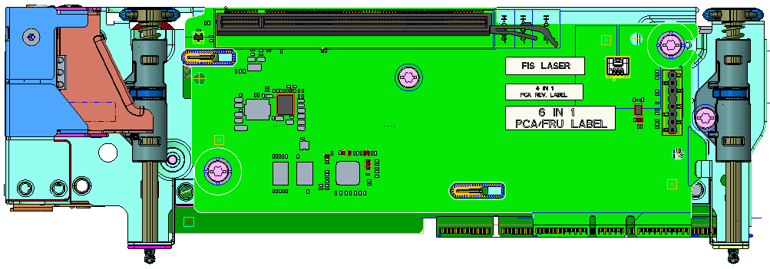
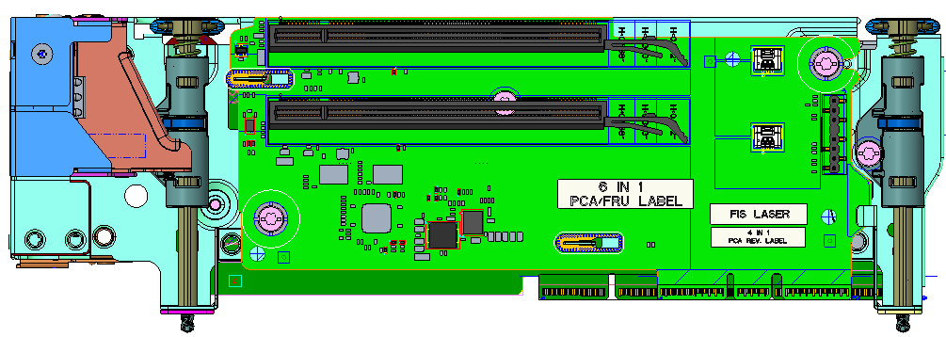
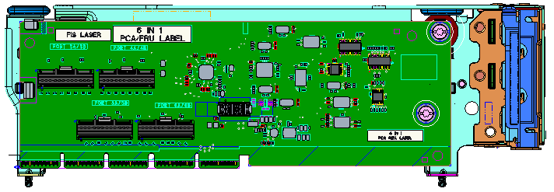
Hpe proliant DL380 Gen10 Plus riser options (continued)
Y = Yes; D = Default; O = Optional; Gray = Not supported or slot/connector not present
D
F
Teritary
E,F,J,O
E
G
Secondary
A,B,C,C+D,G,H,I,K,L,N,O
Primary
A,B,C,C+D,G,H,I,K,M

Slide 60
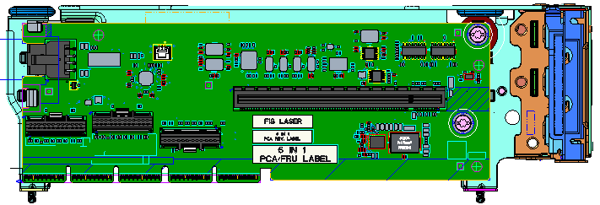
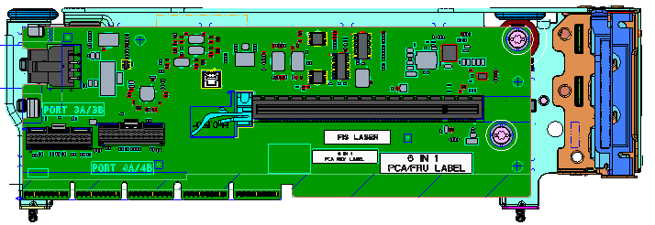
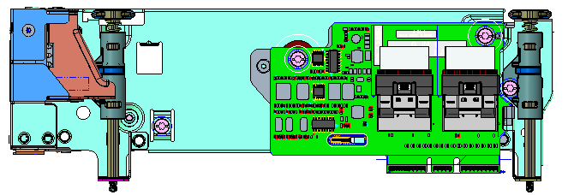
Hpe proliant DL380 Gen10 Plus riser options (continued)
Y = Yes; D = Default; O = Optional; Gray = Not supported or slot/connector not present
H
Teritary
E,F,J,O
Secondary
A,B,C,C+D,G,H,I,K,L,N,O
J
Primary
A,B,C,C+D,G,H,I,K,M

Slide 61
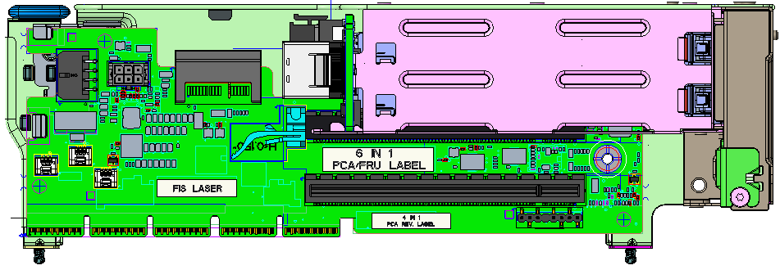
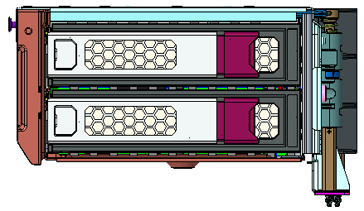
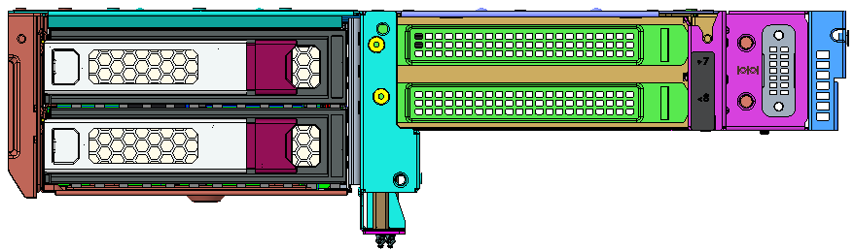
Hpe proliant DL380 Gen10 Plus riser options (continued)
Y = Yes; D = Default; O = Optional; Gray = Not supported or slot/connector not present
K
N
Teritary
E,F,J,O
M
O
Secondary
A,B,C,C+D,G,H,I,K,L,N,O
Primary
A,B,C,C+D,G,H,I,K,M

Slide 62
HPE PROLIANT DL3x0 Gen10 Plus operating systems & hypervisors support

Slide 63

HPE ProLiant DL3x0 Gen10 Plus o/s and hypervisors support
Microsoft Windows Server
  2016 (LTSC): Standard, Datacenter, Essentials
  2019 (LTSC): Standard, Datacenter, Essentials
Linux
  RHEL 7.9 & 8.2—Includes KVM
  SLES 12 SP5 & 15 SP2—Includes Xen & KVM
  Ubuntu 20.04 LTS (3CQ’21)
Virtualization
  VMware 6.7 U3 w/P03, 7.0 U2
  Microsoft Hyper-V 2016, 2019

Slide 64
HPE PointNext Services

Slide 65
Redefining the product experience
From break-fix to a game-changing support experience
Enabling self-serve and self solve
PRODUCTS
+
SERVICES
= EXPERIENCE
Digitally transformed to provide customers with a personalized experience that provides multiple communication options, on demand knowledge intelligence, digital engagement, enhanced self-solve solutions, and actionable AI insights.
Easier access to our experts
Streamlined access to our own product experts, overcoming some of the previous complex escalations and giving more options to connect, whether it be by phone, by chat, or those who prefer a self-solve approach.
Get the most from your product
Going beyond traditional break-fix support by offering expert technical advice and product specific lifecycle services to change the conversation from “fix my product” to “how can we get the most from your product.”

Slide 66


What is Tech Care?
From “fix my hardware” to “help me get the most from my HPE product”
1
Single support experience that adapts seamlessly for each HPE product type.
Simplified
support
Digital
experience
A digital experience providing automated and proactive AI insights, self-serve and self-solve capabilities.
2
Direct
access to
experts
Easy access to our experts and their knowledge, with real-time collaboration and tech-tips video library.
3
4
General technical guidance from our experts on operational best practices, over its lifecycle.
Operational
guidance
Service
extensions
5
Portfolio of standardized and modular supplemental product lifecycle services.

Slide 67
1—A simpler portfolio
Critical
Direct connect to expert in
15 minutes for critical (S1) cases
Outage management
6hr hardware repair
Single product experience
Replacing Foundation Care and Proactive Care
3 SLA OPTIONS
Critical
Essential
Basic
Essential
Direct connect to expert in
15 minutes for critical (S1) cases
4hr hardware onsite
SCALABLE
ONE OFFER
Basic
Access to expert in 2 hours—9x5
Next business day hardware onsite
Adapts to the product type
Hardware support e.g., HPE ProLiant DL etc.
Hardware + software support e.g., HPE Synergy, HPE SimpliVity, HPE 3PAR etc.

Slide 68
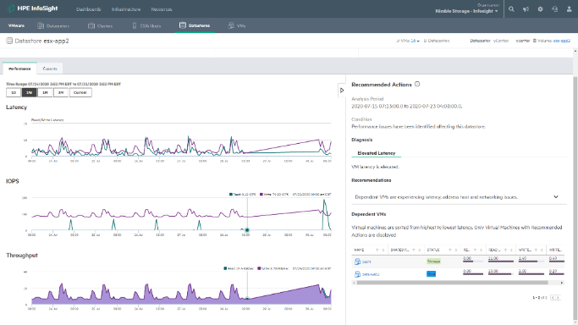

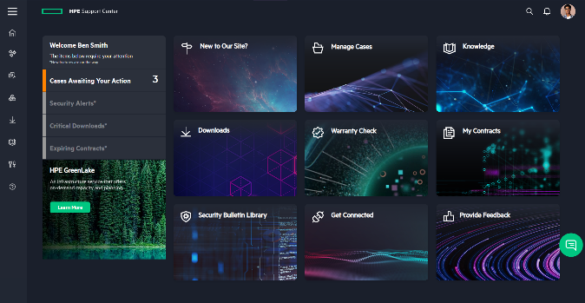
2—digital experience with HPE Infosight and DCE
Self-Serve, Self-Solve
Personalized insights
Intuitive case management
Virtual expert
Smart search
Digital
Customer
Experience
AI-driven management
Predictive support automation
Preemptive recommendation
Proactive management
Continuously learning engine
Cross stack capabilities
HPE InfoSight

Slide 69
3—Easy Access to our experts
Direct Access
Access to specialist engineers over phone or live chat, matched to your product need.
Virtual Remote Guidance
Real-time remote guidance with our support engineers, seeing what the onsite team sees.
Tech Tip’s
100’s of videos and configuration guides by HPE engineers on how to get the best from HPE products.
Community Forums
HPE assisted forums for community sharing, best practices and answers to common questions.
Notes:
For severity 1 critical incidents, HPE aims to either connect the Customer to a product specialist or call the Customer back within 15 minutes. For noncritical incidents, HPE may connect the Customer to a product specialist or call the Customer back within one hour.

Slide 70




4—Get the most from my product
ENABLEMENT
Usage & process support
Configuration guidance & whitepapers
PROACTIVE
AI predictive alerts*
FW/SW guidance
Moderated forums
Workload alerts & guidance*
Risk mitigation guidance*
Tech tip videos
REACTIVE
Auto case logging*
Fast access to experts
Outage management
Incident dashboard
Collaborative support
EXPANSION
Capacity guidance
Performance alerts & guidance*
Workload simulation*
* Connected product with HPE InfoSight required

Slide 71
5—services to augment HPE Pointnext TECH CARE
Additional Services
Installation & startup
Performance tuning
Security assessment
Data migration
Firmware deployment
Technical training
Workload consulting
Software deployment
Retire and sanitize
Plus many more…
HPE Pointnext Tech Care
HPE Pointnext Tech Care
HPE Pointnext Tech Care
Maintain and protect my product for me
Keep my product at peak performance
Give me a hands-off operational experience

Slide 72
Q&A

Slide 73
Thank you
a50003483ENW

